Slide 1
Introduction to Power Platform

Slide 2



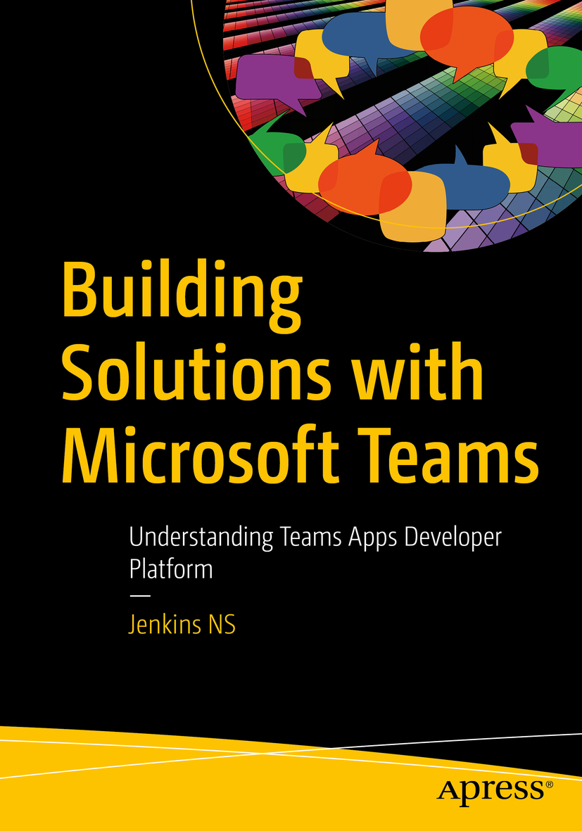









Jenkins NS
Modern Workplace Solution Architect | Consultant
Chennai, India
Founder @
MVP | MCT | International Speaker | Author | Trainer
Microsoft Teams, Power Platform and SPFx Specialist
M365 Bangalore Organizer
aMS Ambassador
@jenkinsns
https://www.linkedin.com/in/jenkinsns/
http://www.jenkinsblogs.com
https://www.youtube.com/user/jenkinsnss

Slide 3
Course agenda
Module 1 Introduction to Microsoft Power Platform
Module 2 Introduction to Microsoft Dataverse
Module 3 Get Started with Power Apps
Microsoft Power Platform overview
Microsoft Dataverse overview
Introduction to Power Apps
Lab 0: Setup lab environment
Lab: Data modeling
How to build a canvas app
How to build a model-driven app
Lab: How to build a canvas app
Lab: How to build a model-driven app

Slide 4
Course agenda (continued)
Module 4 Get Started with Power Automate
Module 5 Get Started with Power BI
Module 6 Get Started with Power Virtual Agents
Power Automate overview
Power BI overview
Power Virtual Agents overview
How to build an automated solution
How to build a simple dashboard
Lab: How to build a simple chat
Lab: How to build an automated solution
Lab: How to build a simple dashboard

Slide 5
Course agenda (continued)
Module 7 Managing Microsoft 365 Users and Groups
Managing User Accounts and Licenses
Lab – Manage Users with the Microsoft 365 admin center
Manage Passwords and Authentication
Lab – Manage Password Policies
Managing Groups in Microsoft 365
Lab – Manage Microsoft 365 Groups
Managing Users and Groups with PowerShell
Lab – Manage Users with PowerShell
Configuring Administrative Access
Lab – Configure Service Administrators

Slide 6
Module 1: Microsoft Power Platform overview

Slide 7
Lesson introduction
In this lesson, you will:
Learn the components and features of Microsoft Power Platform
Identify when to use each Microsoft Power Platform component application to create business solutions
Learn the value of using Microsoft Power Platform to create business solutions

Slide 8
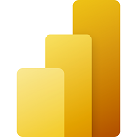





Microsoft Power Platform
The low-code platform that spans Office 365, Azure, Dynamics 365, and standalone applications
Power BI
Business analytics
Power Apps
Application development
Power Automate
Process automation
Power Virtual Agents
Intelligent virtual agents
Data connectors
AI Builder
Dataverse
Notes:
Microsoft Power Platform is comprised of four key products: Power Apps, Power Automate, and Power BI and Power Virtual Agents.
Power Apps provides a rapid low code development environment for building custom apps for business needs. It has services, connectors, and a scalable data service and app platform (Dataverse) to allow simple integration and interaction with existing data. Power Apps enables the creation of web and mobile applications that run on all devices. People use apps for every area of their lives, and business should be no exception. Most out of the box solutions do not meet exact business needs or integrate well with other business programs. Power Apps eases users into app development with a simple interface so that every business user or pro developer can build custom apps.
Power Automate lets users create automated workflows between applications and services. It helps automate repetitive business processes such as communication, data collections, and decision approvals. If you have ever been performing a repetitive task for work and think, “This is so easy a monkey could do it,” Power Automate is your new best friend. Don't waste important productive hours on drafting the same email for a weekly update or walking approvals through. Not only for the individual user, Power Automate allows for the creation of enterprise-grade process automation. Power Automate's simple interface allows every level of user to automate work tasks from beginners to seasoned developers.
Power BI (Business Intelligence) is a business analytics service that delivers insights for analyzing data. It can share those insights through data visualizations which make up reports and dashboards to enable fast, informed decisions. Power BI scales across an organization, and it has built-in governance and security allowing businesses to focus on using data more than managing it. You can consider Power BI as the analysis and insights leg of Microsoft Power Platform. It takes business data and allows you to display it in ways that makes the most sense to users. A Power BI dashboard could potentially replace a standing meeting to report out on company metrics such as sales data, progress against goals, or employee performance.
Power Virtual Agents enables anyone to create powerful chatbots using a guided, no-code graphical interface, without the need for data scientists or developers. Power virtual agents addresses many of the major issues with chatbot building. It eliminates the gap between subject matter experts and the development teams building the chatbots. It removes the complexity of exposing teams to the nuances of conversational AI and the need to write complex code. It minimizes the IT effort required to deploy and maintain a custom conversational solution by empowering subject matter experts to build and maintain their own conversational solutions.

Slide 9
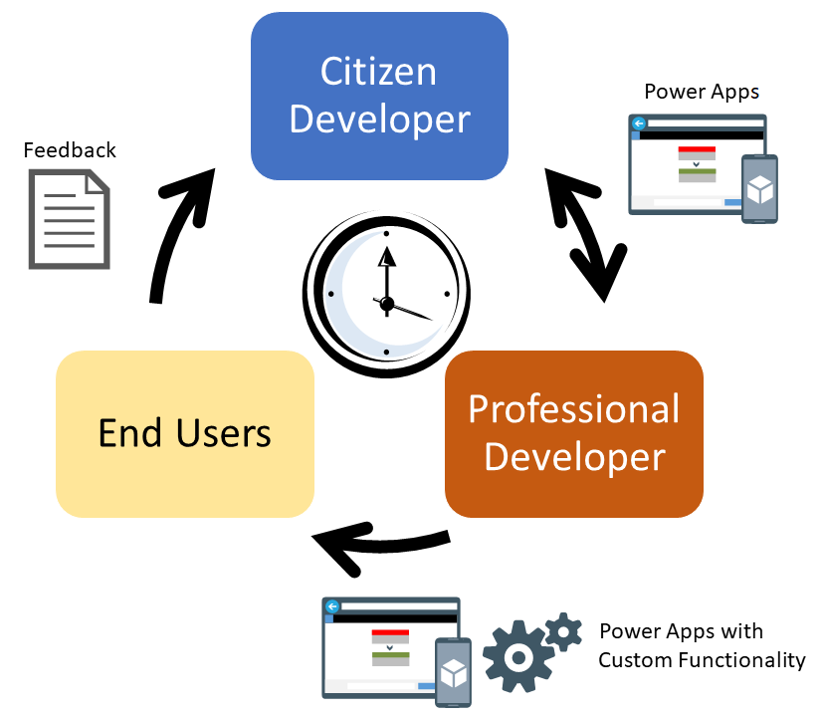
The business value of Microsoft Power Platform
Easily adapt to changing workforce expectations by delivering custom, collaborative, digital experiences
Become more agile by quickly building solutions based on your organizations rapidly changing needs
Reduce extra costs associated with custom applications by leveraging low code/no code tools
Notes:
Changing workforce expectations: As millennials and Gen Z become most of the workforce, organizations need adapt to fit the way they work. They have grown up in a world or tailored experiences and collaborating through social medial. To best leverage their abilities, organizations need to be able to deliver more custom, streamlined, and collaborative digital experiences.
Increased costs for custom application development: Building custom applications is time consuming and expensive. Not only do you need to factor in the costs to initially custom develop an application, but you need to factor in the costs to maintain it.
Need to become more agile: Historically, solutions can take months to build and roll out. Once deployed, it can take weeks to implement every minor change. We no longer have that luxury. Business strategies and needs change rapidly, so organizations need to be able to quickly build solutions based on those changing needs.
Need to scale development efficiently: To meet ever changing needs organizations need to change how they develop solutions. By responsibly enabling citizens developers (Power Users) as part of development processes, we can create hybrid development teams that empower the entire organization to grow.

Slide 10
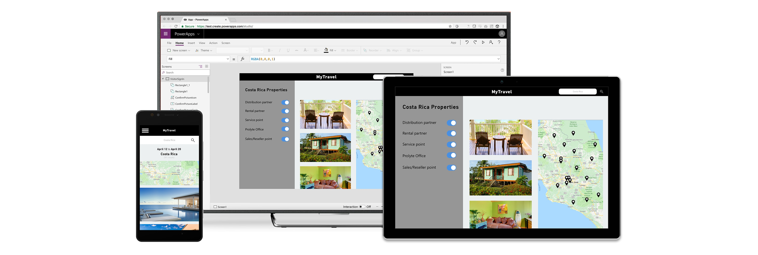
Build and consume solutions for web and mobile with Power Apps
Build highly customized task- and role-based canvas apps with data from one or multiple sources
Generate immersive model-driven apps, starting from your data model and business processes
Consume fully accessible apps across web and mobile, embedded or standalone, on any device
Notes:
Power Apps provides a rapid low code development environment for building custom apps for business needs. It has services, connectors, and a scalable data service and app platform (Dataverse) to allow simple integration and interaction with existing data. Power Apps enables the creation of web and mobile applications that run on all devices.
People use apps for every area of their lives, and business should be no exception. Most out of the box solutions do not meet exact business needs or integrate well with other business programs. Power Apps eases users into app development with a simple interface so that every business user or pro developer can build custom apps.

Slide 11
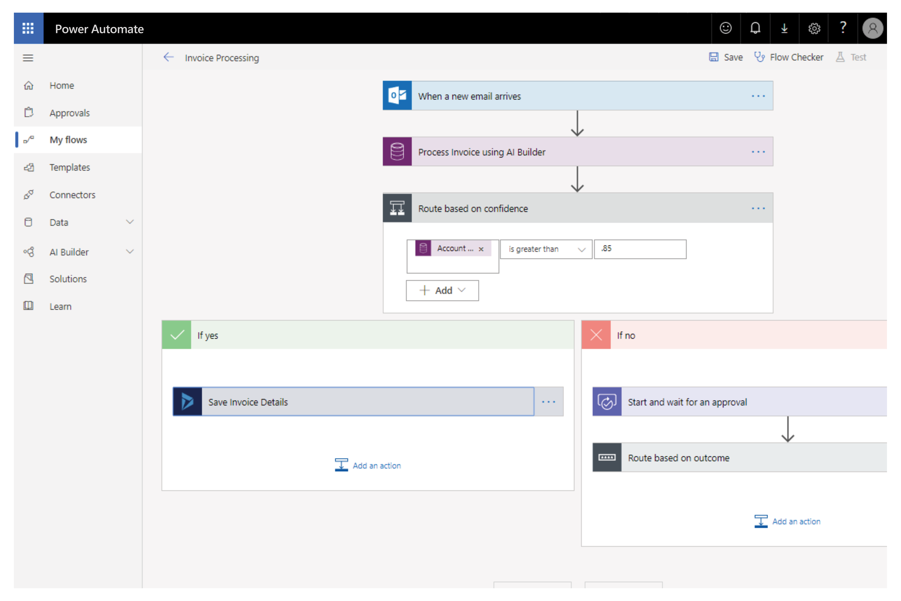
Automate and integrate business processes with Power Automate
Automate and model business processes across your apps and services
From simple automations to advanced scenarios with branches, loops, and more
Trigger actions, grant approvals, and get notifications right where you work
Automate legacy, on-prem and cloud-based applications and services
Notes:
Power Automate lets users create automated workflows between applications and services. It helps automate repetitive business processes such as communication, data collections, and decision approvals.
You can avoid wasting important productive hours on drafting the same email for a weekly update or walking approvals through. Not only for the individual user, Power Automate allows for the creation of enterprise-grade process automation. Power Automate's simple interface allows every level of user to automate work tasks from beginners to seasoned developers.

Slide 12
Gain insights from your data regardless of where it lives with Power BI
Connect to all your data and get a consolidated view across your business through a single pane of glass
Create ad-hoc analysis, live dashboards and interactive reports that are easy to consume on the web and across mobile devices
Build smart apps by infusing insights from your data and drive action with the power of Microsoft Power Platform
Notes:
Power BI (Business Intelligence) is a business analytics service that delivers insights for analyzing data. It can share those insights through data visualizations which make up reports and dashboards to enable fast, informed decisions. Power BI scales across an organization, and it has built-in governance and security allowing businesses to focus on using data more than managing it.
You can consider Power BI as the analysis and insights leg of Microsoft Power Platform. It takes business data and allows you to display it in ways that makes the most sense to users. A Power BI dashboard could potentially replace a standing meeting to report out on company metrics such as sales data, progress against goals, or employee performance.

Slide 13
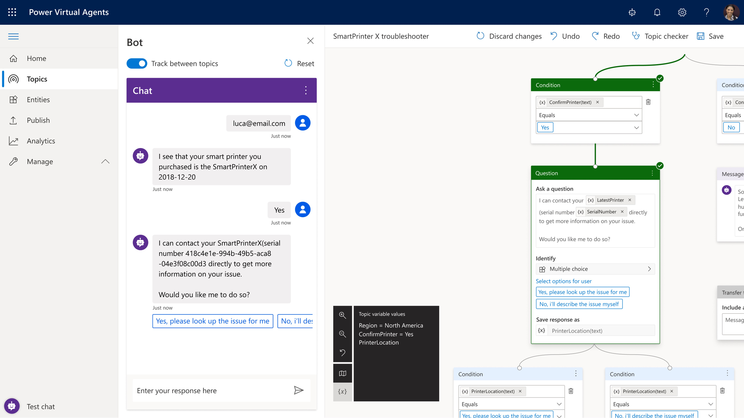
Build powerful chatbots with Power Virtual Agents
Enable subject matter experts to easily create powerful chatbots using a guided, no-code graphical interface—all without the need for data scientists or developers
Enable the virtual agent to act on the customer’s behalf. Easily integrate your virtual agent with hundreds of services and systems out of the box or create custom workflows
Keep an eye on how your virtual agent is performing by using conversational metrics and dashboards. Get in-depth AI-driven insights to improve bot performance
Notes:
Power Virtual Agents enables anyone to create powerful chatbots using a guided, no-code graphical interface, without the need for data scientists or developers.
Power virtual agents addresses many of the major issues with chatbot building. It eliminates the gap between subject matter experts and the development teams building the chatbots. It removes the complexity of exposing teams to the nuances of conversational AI and the need to write complex code. It minimizes the IT effort required to deploy and maintain a custom conversational solution by empowering subject matter experts to build and maintain their own conversational solutions.

Slide 14

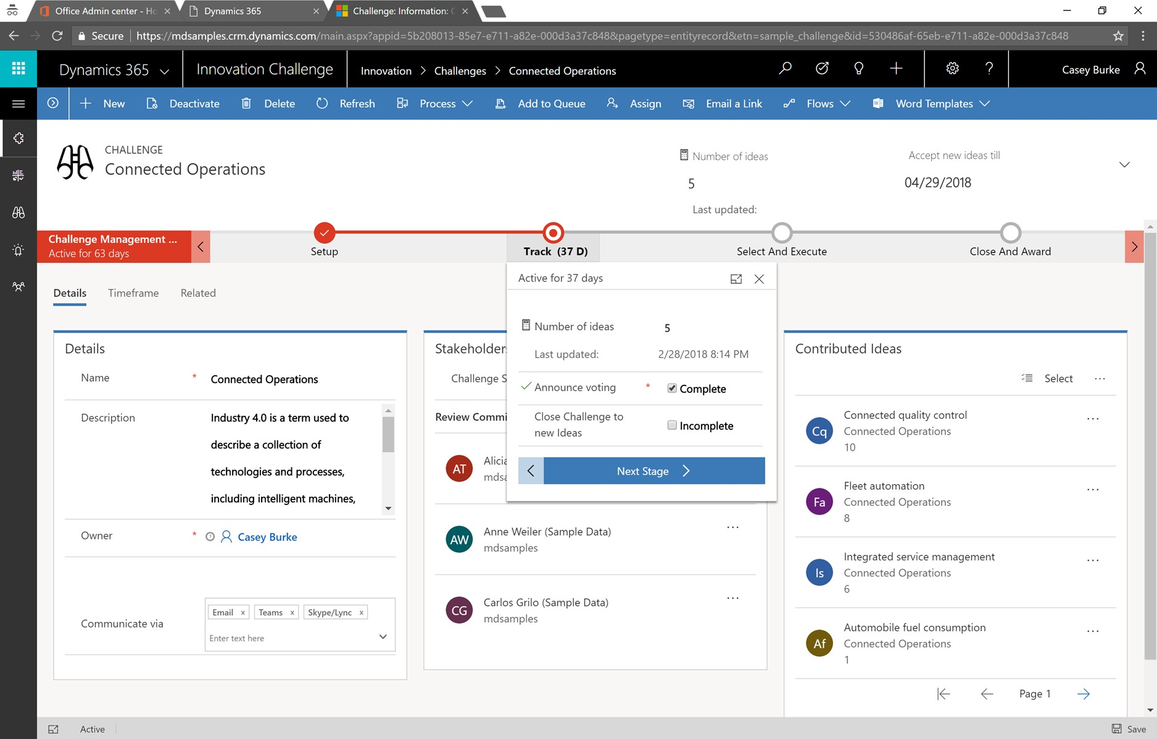
Put all your data to work with Dataverse
Jumpstart apps using a standardized data model with business logic, security and integration built-in
Extend to your own needs and integrate across your apps and services
Seamless Dynamics 365, Office 365, and Azure integration, augmented with data from industry partners
Notes:
Dataverse is a scalable data service and app platform which lets users securely store and manage data from multiple sources and integrate that data in business applications using a common data model to ensure ease and consistency to users. Dataverse is the common currency that enables the components of Microsoft Power Platform to work together. It’s the foundation that enables the consolidation, display, and manipulation of data.

Slide 15
Data connectors
Connectors are available for use in multiple products:
Power Automate
Power Apps
Logic Apps
Custom connectors:
An advantage of building custom connectors is that they can be used in different platforms, such as Power Apps, Power Automate, and Azure Logic Apps
It allow you to extend your app by calling a publicly available API, or a custom API you're hosting in a cloud provider, such as Azure.
You can create custom connectors using 3 different approaches:
Using a blank custom connector
From an OpenAPI definition
From a Postman collection
Notes:
Microsoft Power Platform is made powerful by its ability to leverage data across many platforms. To do this, components of Microsoft Power Platform use connectors. You can think of connectors as a bridge from your data source to your app or workflow which allows information to be conveyed back and forth. Connectors allow you to extend your business solutions across platforms and add functionality for your users, and Microsoft Power Platform has more than 275 connectors with the ability to build custom connectors as well.
It is important to note that premium connectors require a paid plan for use. The connector reference in the summary and resources unit lists all connectors and whether they are considered standard or premium. Custom connectors are also considered a premium feature.
Both of these data source types are commonly used to bring data and additional functionality to your solutions.
As you can see, connecting to data sources allows you to integrate disparate parts of your business solutions to build them out cohesively.
Tabular data: A tabular data source is one that returns data in a structured table format. Power Apps can directly read and display these tables through galleries, forms, and other controls. Additionally, if the data source supports it, Power Apps can create, edit, and delete data from these data sources. Examples include Dataverse, SharePoint, and SQL Server.
Function-based data: A function-based data source is one that uses functions to interact with the data source. These functions can be used to return a table of data, but offer more extensive action such as the ability to send an email, update permissions, or create a calendar event. Examples include Office 365 Users, Project Online, and Azure Blob Storage.
Triggers are only used in Power Automate and prompt a flow to begin. Triggers can be time based, such as a flow which begins every day at 8:00 am, or they could be based off of an action like creating a new record in a table or receiving an email. You will always need a trigger to tell your workflow when to run.
Actions are used in Power Automate and Power Apps. Actions are prompted by the user or a trigger and allow interaction with your data source by some function. For example, an action would be sending an email in your workflow or app or writing a new line to a data source.

Slide 16
Data Loss Prevention, compliance, privacy, and accessibility
Data loss prevention policies:
Data loss prevention (DLP) policies can be scoped at the environment level or tenant level, offering flexibility to craft sensible policies that strike the right balance between protection and productivity.
Compliance and data privacy:
Microsoft is committed to the highest levels of trust, transparency, standards conformance, and regulatory compliance.
Data Protection
Resources to manage GDPR Compliance
Accessibility in Microsoft Power Platform:
Microsoft Power Platform is accessible and inclusive to all kinds of users all over the world.
An accessible canvas app will allow users with vision, hearing, and other impairments to successfully use the app.
Notes:
Data Protection:
Data as it is in transit between user devices and the Microsoft datacenters are secured. Connections established between customers and Microsoft datacenters are encrypted, and all public endpoints are secured using industry-standard TLS. TLS effectively establishes a security-enhanced browser to server connection to help ensure data confidentiality and integrity between desktops and datacenters. API access from the customer endpoint to the server is also similarly protected. Currently, TLS 1.2 (or higher) is required for accessing the server endpoints.
Resources to manage GDPR Compliance
The European Union General Data Protection Regulation (GDPR) is one of the newest privacy regulations enacted that gives rights to people to manage their personal data. A complete discussion of GDPR is beyond the scope of this content, however Microsoft Power Platform does fully support the GDPR. For more GDPR resources and information, visit the Trust Center at https://www.microsoft.com/TrustCenter/Privacy/gdpr/default.aspx .

Slide 17
Pulling it all together
Microsoft Power Platform helps to add value to any business by analyzing, acting and automating
Build custom apps in Power Apps
Automate processes with Power Automate
Analyze data with Power BI
Build powerful chatbots with Power Virtual Agents
Notes:
Although we live in a data driven world, your business can find it difficult to take advantage of the data you have access to. Sales, customer, and employee data should drive our business decisions, but where do we even start? Microsoft Power Platform can add value to any business by helping you to analyze, act, and automate. Act by building custom apps in Power Apps, automate processes based on the data you collect in Power Automation, and analyze the data you have collected in Power BI.
Consider a business that has IT equipment for general use. Currently equipment check-out is conducted by visiting the IT office and if the product is available, writing your name and the equipment name in a notebook. Employees may have to visit IT several times before equipment becomes available, and IT personnel must drop their tasks to check on equipment status or go to collect it for the employee. Sometimes employees hold onto the equipment longer than they intend and an IT personnel spends time tracking it down. In addition, important equipment information such as serial number, warranty details, and instructions for use are kept somewhere in the IT office. How can Microsoft Power Platform improve this process?
Power Apps allows us to build an app that has all equipment listed, the status of that equipment, and even important details such as use instructions. This way employees can check out available equipment, walk to IT at a specified pick up time where the equipment will be ready, and even access the use instructions or flag an equipment malfunction from their phone or tablet. Power Automate can read when equipment needs to be returned and send reminder emails out, or even a warning that the equipment is late being checked in. Users can see when equipment is booked through the app and request check out for a future date at which time Power Automate can send them a reminder to pick the equipment up and IT a reminder to have it ready. Power BI can take all the data generated from the app and analyze it to help you understand what equipment is used most often and by whom. This way you can decide if you need additional equipment, if some users or departments need dedicated equipment, and when your equipment has reached the end of its usefulness.
This is only one common scenario in which Microsoft Power Platform can transform the way businesses work. Consider your own business and what processes take up valuable time and are a burden to customers or employees. How can you leverage Microsoft Power Platform to improve them?

Slide 18

Module 1 lab
Lab 0: Setup lab environment

Slide 19
Module 2: Microsoft Dataverse overview

Slide 20
Lesson introduction
In this lesson, you will:
Explain what environments, tables, columns, and relationships are in Microsoft Dataverse
Describe the difference between Dataverse and Common Data Model
Explain use cases and limitations of business rules and process flows
Notes:
Dataverse is a cloud-based, low-code data service and app platform, which allows you to leverage the security and connectivity of Microsoft services.
Dataverse connects easily to all aspects of Microsoft Power Platform so that you can fully control, automate, and strengthen your business.
With standard tables and columns, as well as the ability to easily define relationships between your data, Dataverse was built for powerful, scalable solutions.

Slide 21
Overview of Microsoft Dataverse
Dataverse: Database storing a set of standard and custom data structures called tables
Common Data Model: Set of open-sourced, standardized, extensible data tables and relationships
Part of the Open Data Initiative
Notes:
Dataverse is a cloud-based solution that easily structures a variety of data and business logic to support interconnected applications and processes in a secure and compliant manner. Managed and maintained by Microsoft, Dataverse is available globally but deployed geographically to comply with your potential data residency. It is not designed for stand-alone use on your servers, so you will need an internet connection to access and use it.
Dataverse is designed to be your central data repository for business data, and you might even be using it already. Behind the scenes, it powers many Microsoft Dynamics 365 solutions such as Field Service, Marketing, Customer Service, and Sales. It is also available as part of Power Apps and Power Automate with native connectivity built right in. The AI Builder and Portals features of Microsoft Power Platform also utilize Dataverse.
The ease of setting up a Dataverse database and standardized data model under it simplifies your ability to concentrate your efforts on building solutions without worrying about infrastructure, storage, and data integration. With your data stored in Dataverse, there are many different ways to access it. You can work with the data natively with tools such as Power Apps or Power Automate. Or through connectors and APIs you can connect to the Common Data Service from any business solution. With the power of features such as role-based security and business rules you can trust your data is safe no matter how it is accessed.
Microsoft Dataverse defined
A Dataverse database is a single instance of Dataverse which stores data in a set of standard and custom data structures called tables. A table is a logical set of records (rows) that is used to store data. These are like tables in a relational database, but there are subtle differences. Rows (records) within a table contain many columns (fields) to manage individual pieces of information about a single row.

Slide 22
Dataverse for Teams
Delivers a targeted set of features needed for creating apps, flows and more within Microsoft Teams.
Most of the standard tables provided with a typical Dataverse environment will not be present as part of Dataverse for Teams
Notes:
Applications within a team in Microsoft Teams have access to a Dataverse for Teams environment. Dataverse for Teams is a common platform that allows all these interfaces to have a unified understanding of how the data is modeled and consumed. Dataverse for Teams delivers a targeted set of the features commonly needed for creating apps, flows, and more within Teams. If your organization requires additional capabilities, such as more granular control for security and governance, or capacity beyond the approximately 1 million rows a Dataverse for Teams environment can contain, Dataverse for Teams can be upgraded to Dataverse.

Slide 23
Identify tables and columns in Dataverse for Teams
Types of tables:
Standard: Base set of tables, created for every instance of a Dataverse database
Custom: Created for a specific business application
Columns:
Store discrete pieces of information within a record in a table
Every column has a type, which defines the way you store the data (example: Date columns)
Notes:
Types of tables
Some of the types of tables are:
Standard - The base set of tables that are created for every instance of a Dataverse database. You can add more columns to any table, but you can only delete columns from a custom table.
Custom - Custom tables are created for a specific business application. All licensed users of Dataverse can access custom tables if they are assigned proper security permissions to do so.
Complex - Tables that contain complex, server-side business logic, including real-time workflows or plug-ins. Some of the tables that are used in Dynamics 365 applications are complex. Care must be taken if you add server-side logic to ensure that users have the proper license to use the complex table. Additional information about complex tables can be accessed by following the link within the summary unit of this module.
Always use standard tables and columns when possible. You can rename a table if that makes the table more understandable in the context of your solution. Always review the list of standard tables and make sure a standard table will not meet your needs before you create a new table.

Slide 24
Understand relationships
Relationships: Represent the way that tables are connected
One-to-many relationships:
Can be “parent-child” relationships
Example: An invoice (parent table) can have many line items (child rows)
Many-to-many relationships:
Example: A Contact can attend multiple Events, and an Event can have many Contacts attend
Notes:
Tables that relate to one another have a relational connection. Relationships between tables exist in many forms, but the two most common are one-to-many and many-to-many, both of which are supported by Dataverse.
One-to-many relationships are also known as parent-child relationships. In the previous invoice example, the invoice table would be the parent and the line items would be part of the child table. An invoice can have zero, one, or many line items (child rows), but the line item will always be related to just one invoice (parent record). Typically, the child records will not exist without a parent record.
A column that only allows unique values, such as invoice number, is used to identify the parent record. This unique column is called a key. The same value (the parent key) is stored in the related child rows. This column is called a foreign key when the child record is used to store the parent key value. Ingeniously, filtering is used to display child records with a value in the foreign key that matches the key value in the parent record. This allows applications to display the child records (line items in the previous example) that belong to a particular parent record (invoice in the previous example). This concept underlies many business software applications.

Slide 25
Module 2 lab
Lab 1: Data modeling

Slide 26
Module 3: Introduction to Power Apps

Slide 27
Lesson introduction
In this lesson, you will:
Learn what Power Apps is and the business value it creates
Learn how one of the world’s largest airports is digitizing its processes using Power Apps
See Power Apps in action and learn some of the options for making your first app

Slide 28
Power Apps and what it can do for you
Low/no-code platform for building apps
Work with data where it lives
Types of Power Apps:
Canvas apps: Build an app from a blank canvas
Model-driven apps: Build from data in Microsoft Dataverse
Portals: Externally-facing websites
Add artificial intelligence to your app with no code
The prediction model: Create a model with AI Builder that can predict a yes or no answer based on historical data
Notes:
Do you have inefficient or legacy business processes that you would like to modernize? Are you still moving information around using paper or even a shared Excel workbook? Do you want to be able to perform these business processes from different devices like PCs or mobile phones? Then you need Power Apps.
Power Apps is a no-code/low-code platform for building apps that builds off of concepts similar to formulas in an excel workbook such as SUM and TEXT. You can use Power Apps to build simple solutions like vehicle inspection forms and status reports or complex business solutions for purchasing processes and inventory management. If you can envision an app to solve a business problem, then you can use your existing skills to build it. Although this module is geared towards business users with little background in computer science and coding, Power Apps offers advanced functionality and the ability for seasoned developers to design complex applications with ease.

Slide 29
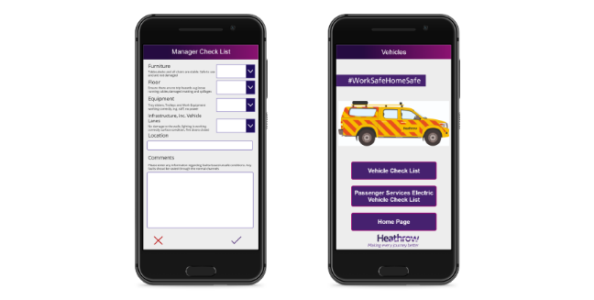
Canvas apps
Canvas apps are a great option when you want to build an app from a blank canvas. You start by choosing the screen size: tablet or mobile, then you have a blank screen from which to build
You can interact with data in your app by adding data sources. Drag and drop various controls and add the desired functionality by writing Excel style formulas. Canvas apps provide you complete flexibility when building your apps

Slide 30
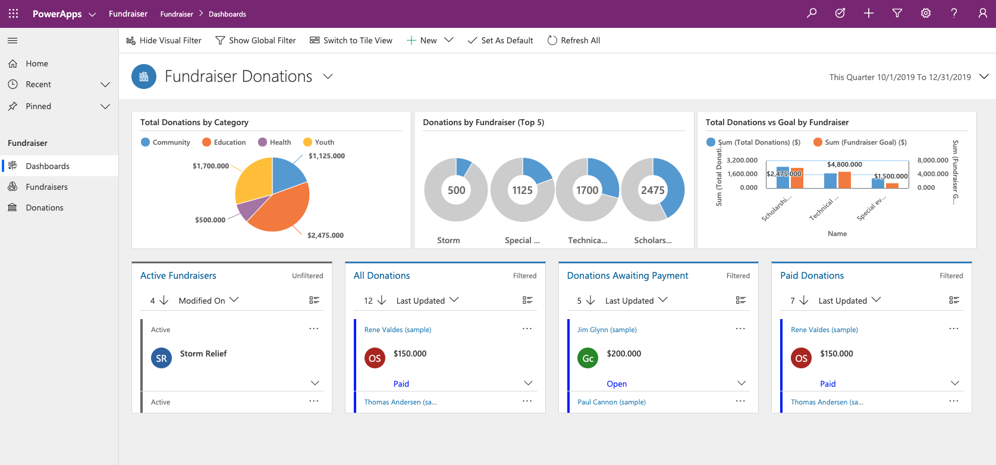
Model-driven apps
Model-driven apps build from data in Microsoft Dataverse. Power Apps will build you a great looking, fully functional app to act upon and interact with this data. With model-driven apps, there is no need to worry about choosing the app size; it is responsive, meaning it works on mobile or tablet with no extra work by you
You define the relationships, forms, views, business rules, and more at the data layer, inside of Dataverse, giving you enough control to get your business result without writing all the formulas yourself

Slide 31
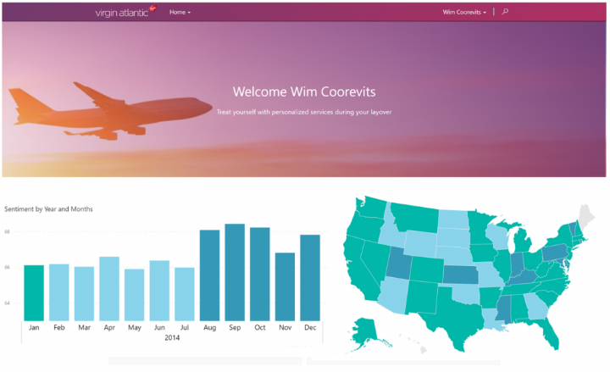
Portals
Portals bring the power of no-code solutions to building externally facing websites. Through the Power Apps interface, you can build an anonymous or authenticated website that allows users to interact with data held in Dataverse.
The same drag and drop experience you enjoy when building apps is available to build these rich, interactive websites.

Slide 32
Power Apps and what it can do for you – continued
Security and Administration:
To manage security for Power Apps you can access admin.powerplatform.com/
Power Apps also has its own set of PowerShell cmdlets for app creators, administrators, and developers that allow you to automate many of your administrative duties
Driving business value:
Users can build apps with ease
Power Apps allows even the most entry level users to reduce paperwork, increase process efficiency, and ensure a single source of truth
Notes:
Security and Administration
In addition, in the Power Automate learn module, you will see that Power Automate has the ability to automate these tasks. You can download the Center of Excellence starter kit, a collection of components or tools that are designed to help get started with developing a strategy for adopting and supporting Microsoft Power Platform, with a focus on Power Apps and Power Automate.
Driving business value
By now you understand that Power Apps does not require traditional "code" like C#, making a low technology barrier to entry. If you know your business process, you can get started writing your first app. For many businesses, this means apps are not coming from IT but instead directly from frontline business users. The same way Finance builds their own Excel workbooks today, they can build their own Power Apps.

Slide 33

Customer case study: Heathrow Airport
76,000 workers and 200,000 travelers in a single day
Empowered front-line workers to build apps and solve problems
Samit Saini: Former security worker turned app maker
Created an app that held security information translated into dozens of different languages
Notes:
A video demo is available at the following link: https://customers.microsoft.com/en-us/story/766053-heathrow-airport-travel-transportation-power-apps

Slide 34
Power Apps in action
Demo: Build an app
Notes:
Demo Power App capabilities or show demo video. A video demo is available at the following link: https://www.microsoft.com/en-us/videoplayer/embed/RE4mPeJ

Slide 35
How to build a canvas app

Slide 36
Lesson introduction
In this lesson, you will:
Learn the basic elements of Power Apps
Exercise: Build a canvas app
Customize elements of your app
Configure and manage app settings

Slide 37
Learn basic elements
Power Apps Studio
Interface you use to build your app
App format
Mobile or tablet
Galleries
Display rows from a table of data
Forms
Display details from a specific table row
Input controls
Text inputs, buttons, dropdowns, toggles, and more
Intelligent controls
Rich controls for more advanced operations
Functions
Glue that binds all the controls, inputs and data sources
Notes:
Power Apps Studio
Power Apps Studio is the name of the web interface you use to build your app. With Power Apps, there is no client to download or install for building apps. Everything is done from the browser by logging into https://make.PowerApps.com.
App format
The first step in creating your app is to choose the format of your app: Mobile or Tablet. While both formats can be used interchangeably on a mobile device, a tablet, or a computer, each has different defaults around sizing of the screens and controls. Once you choose the format for an app, you cannot change it.
Galleries
The Gallery control is used to display records from a table of data. The display of a record is then defined by a template, which you can customize to meet your needs. This allows you to control which fields are shown and how they are formatted. Power Apps will then apply this template automatically to every record in your data.
Forms
Forms are focused on working with a specific table row (record), often based on a selection from a gallery. In this experience, a user browses a gallery to find and select the desired row displaying the details on the form. Forms enable a user to not only view detailed information, but to save new rows and edit existing ones. The various actions performed with forms are controlled by form modes allowing the form to serve many purposes.
Input Controls
To allow you maximum flexibility in customizing your apps, Power Apps has a large selection of Input controls. Text inputs, buttons, dropdowns, toggles, date pickers, and sliders are a few examples. You can add these controls to galleries, forms, and screens to build a functional and aesthetic experience for your app. All inputs have a multitude of settings for default data, formatting, and actions which allow you to build an app that has the right user experience for your business process.
Intelligent Controls
In addition to common inputs as covered above, Power Apps also provides a rich set of controls for more advanced operations. There are hardware-based controls which allow access to the camera, bar code scanner, GPS, and more hardware features. There are also service backed controls like the business card reader or object detector which allow you to add artificial intelligence to your app without writing code.
Functions
Functions are the glue that binds all these controls, inputs, and data sources together. You can use one or more functions to create formulas in your apps. These formulas are similar to the language you use in Excel and can be used for actions such as sending data to a data source, formatting information, creating animations, and more. No complicated code is necessary, simply powerful functions with straightforward inputs to enhance your app.
Now that you have an overview of some of the rich functionality you can achieve with Power Apps, the next section will walk you down the path of building your first app.

Slide 38
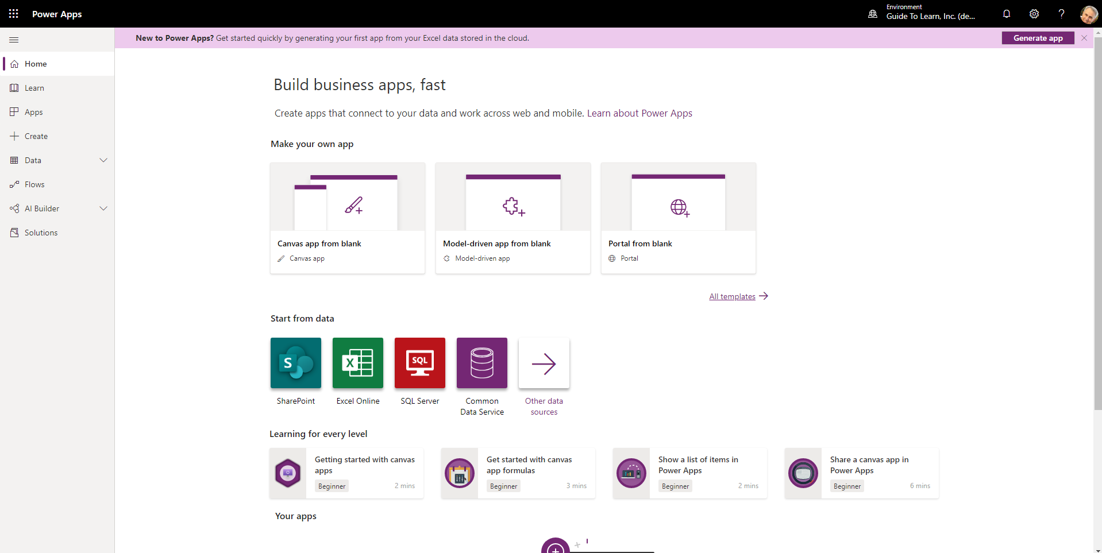
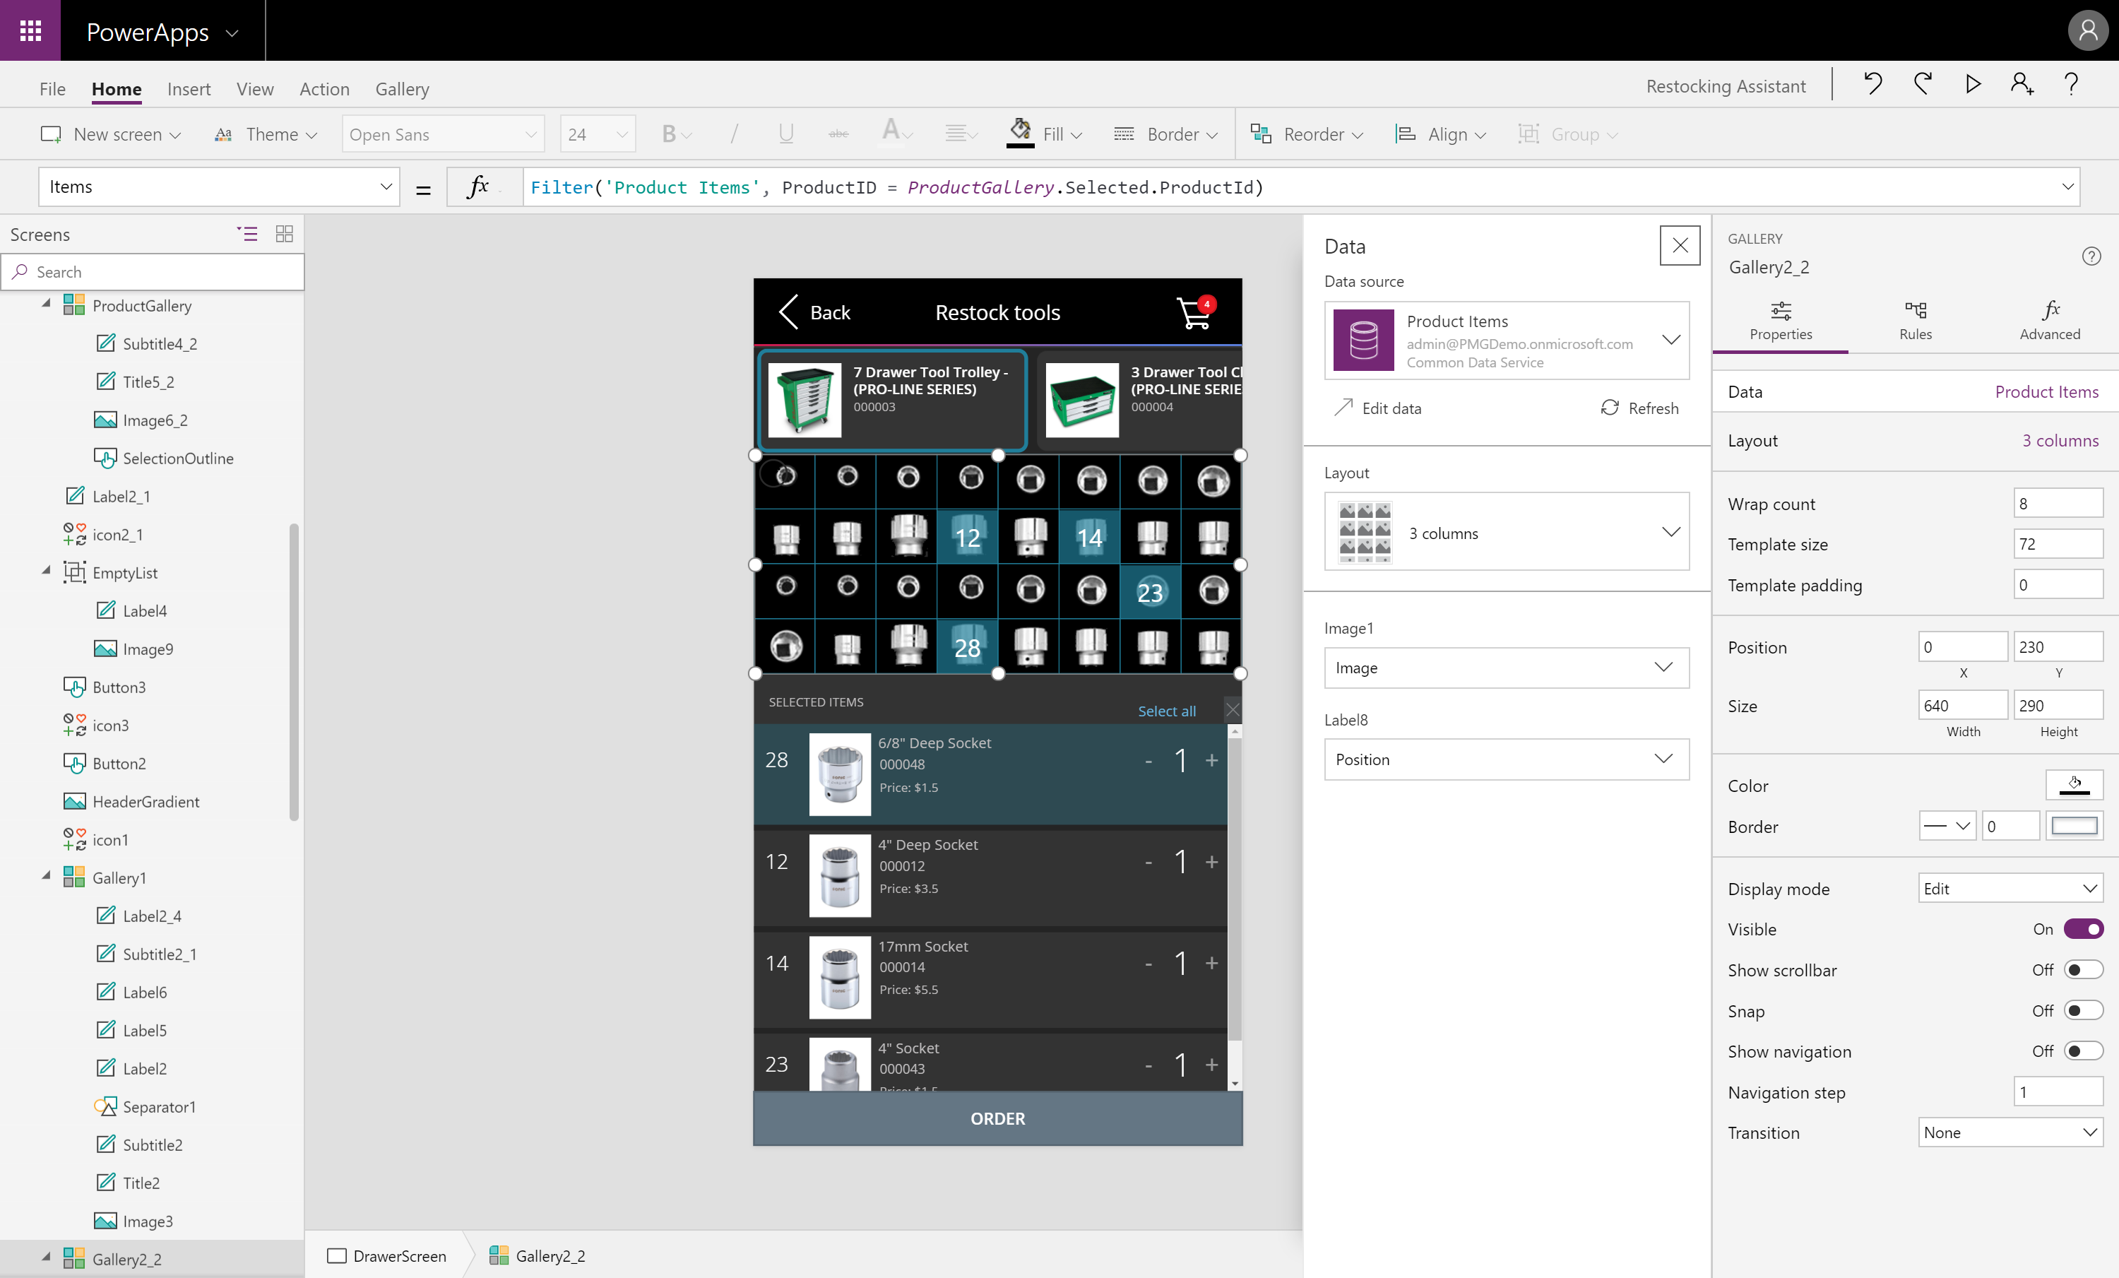
Power Apps Studio
Notes:
Power Apps Studio
Power Apps Studio is the name of the web interface you use to build your app. With Power Apps, there is no client to download or install for building apps. Everything is done from the browser by logging into https://make.PowerApps.com.
The web studio is the premiere authoring experience for creating PowerApps and is the recommend way to build your apps.

Slide 39
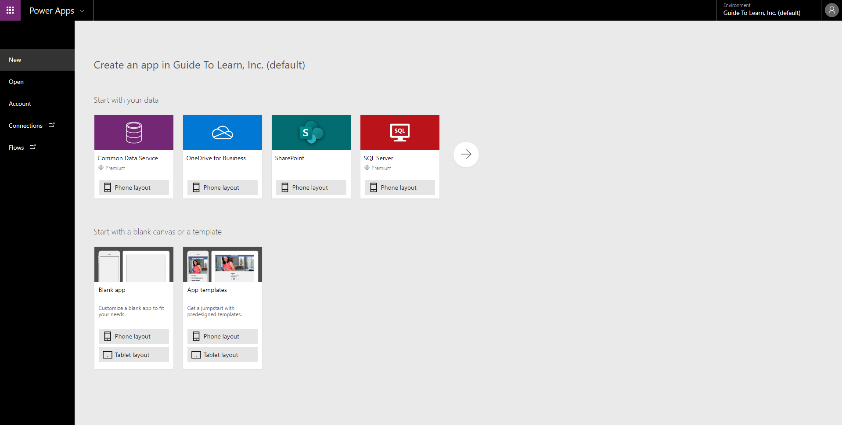
App format
Notes:
App format
The first step in creating your app is to choose the format of your app: Mobile or Tablet. While both formats can be used interchangeably on a mobile device, a tablet, or a computer, each has different defaults around sizing of the screens and controls. Once you choose the format for an app, you cannot change it.

Slide 40
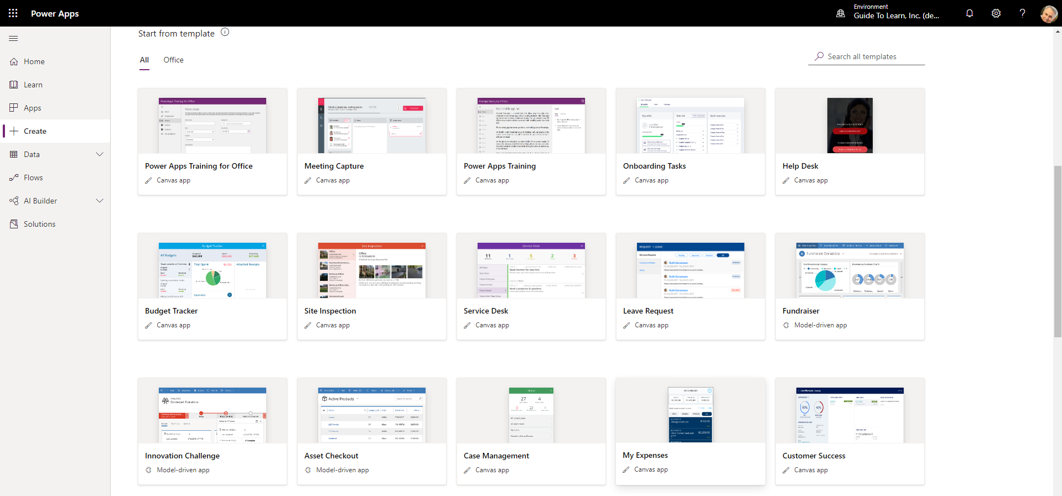
Galleries
Notes:
Galleries
The Gallery control is used to display rows from a table of data. The display of a row (or record) is then defined by a template, which you can customize to meet your needs. This allows you to control which columns are shown and how they are formatted. Power Apps will then apply this template automatically to every row in your data.

Slide 41
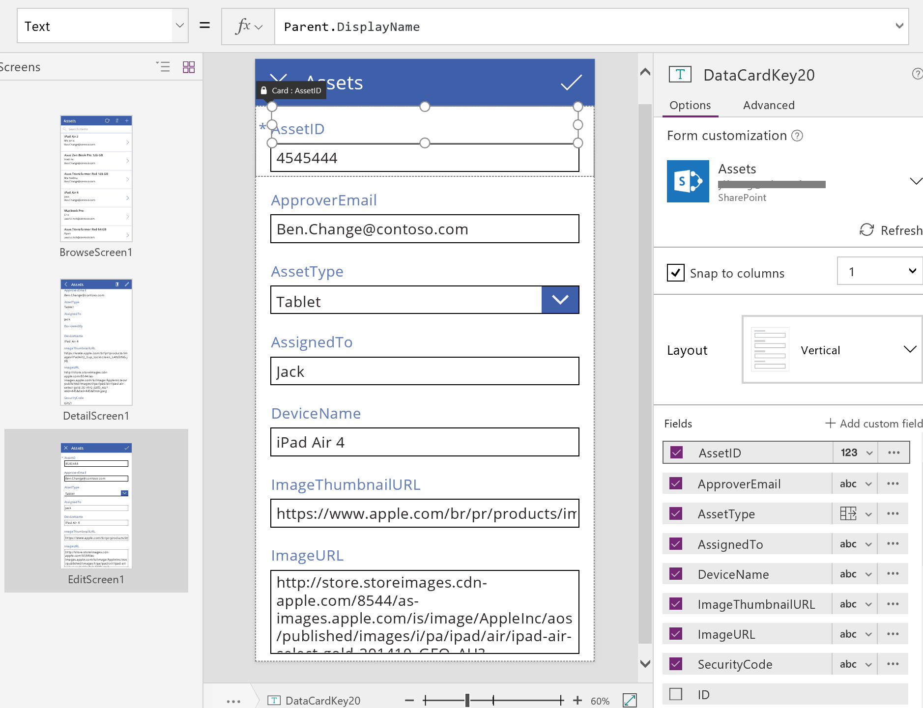
Forms
Notes:
Forms
Forms are focused on working with a specific table row, often based on a selection from a gallery. In this experience, a user browses a gallery to find and select the desired row displaying the details on the form. Forms enable a user to not only view detailed information, but to save new rows and edit existing ones. The various actions performed with forms are controlled by form modes allowing the form to serve many purposes.

Slide 42
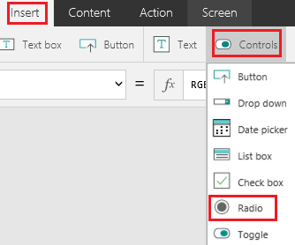
Input Controls
Notes:
Input Controls
To allow you maximum flexibility in customizing your apps, Power Apps has a large selection of Input controls. Text inputs, buttons, dropdowns, toggles, date pickers, and sliders are a few examples. You can add these controls to galleries, forms, and screens to build a functional and aesthetic experience for your app. All inputs have a multitude of settings for default data, formatting, and actions which allow you to build an app that has the right user experience for your business process.

Slide 43
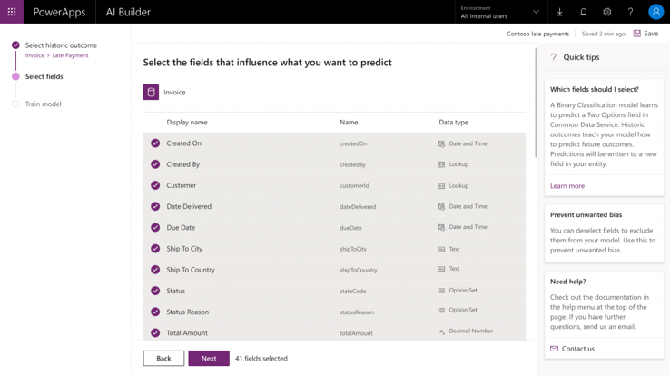
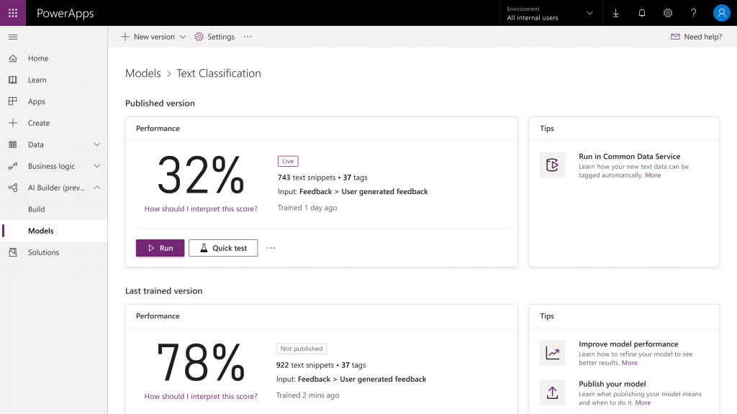
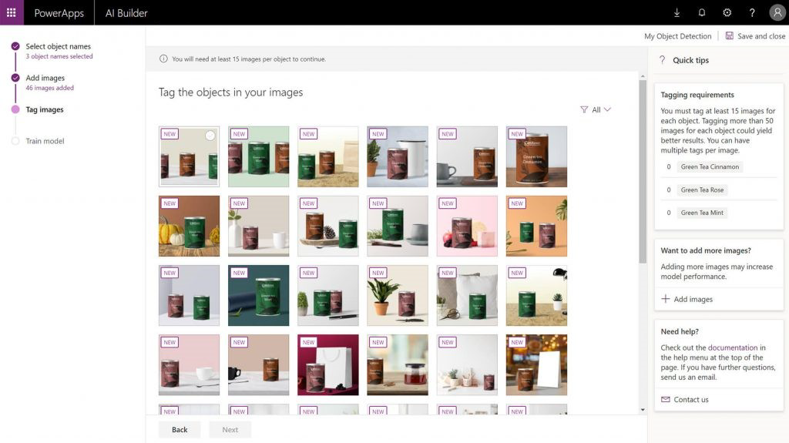
Intelligent Controls
Notes:
Intelligent Controls
Power Apps also provides a rich set of controls for more advanced operations. There are hardware-based controls which allow access to the camera, bar code scanner, GPS, and more hardware features. There are also service backed controls like the business card reader or object detector which allow you to add artificial intelligence to your app without writing code.

Slide 44

Build a canvas app
Connect to a data source
Explore the app
Customize the app
Browse screen
Details screen
Edit/create screen
Explore the generated app
Install the app on your device
Controls in Power Apps
Galleries
Forms
Media
Charts
Notes:
**Can be done as demo or individual exercise**
In this unit, you will generate a canvas app where the data source is a Microsoft Excel workbook that is stored in Microsoft OneDrive for Business. This Excel workbook has a table of different buildings owned by Contoso Manufacturing. Today, they must email the shared workbook between people as they travel to different locations to make updates. With a Power Apps canvas app, they will be able to view the buildings directly from their phones. In addition, they will also be able to edit the information and even add new buildings.
This example uses Excel, but keep in mind that you can use data from many other sources, including Microsoft Dataverse, Microsoft SharePoint, cloud services like Salesforce, and on-premises sources like Microsoft SQL Server. This gives you the flexibility to build your app from your data no matter where it lives. You can also combine data sources within Power Apps to easily create associations between different data sources.
If you do not have a Power Apps account available, you can sign up for a free Power Apps Community Plan. This will allow you to learn and explore Power Apps in your own environment. For more information and to sign up, go to https://powerapps.microsoft.com/communityplan/
The basic Power Apps creator journey will look something like this:
Identify a business need that could be filled by Power Apps
Connect to any necessary data in your Power Apps
Design the app using controls, buttons, and an easy to use interface for your end user to interact with the data to accomplish the business need
Save and publish the app and test functionality
Once satisfied, share the app with end users to give them a better business process
Connect to a data source
To connect to a data source, use the following procedure:
Download the Contoso-Site-Tracking.zip file, extract all of the files, and save them to your OneDrive for Business.
Go to https://make.powerapps.com and sign in with your organizational account.
In the left pane, select Create.
Select Other data sources from the Start from data section.
Under Connections choose OneDrive for Business. If you don't have the connection available, click New connection to create one.
For Choose an Excel file on the right select the Contoso Site Tracking.xlsx file.
For Choose a table click SiteInspector and click Connect.
Power Apps generates the app by inspecting your data and matching it with Power Apps capabilities, so that you get a working app as a starting point. Generated apps are always based on a single list or table, but you can add more data to the app later.
Explore the generated app
Your new three-screen app now opens in Power Apps Studio.
The following figure shows the main development window for Power Apps Studio, which you will learn more about in later units.
Select Play in the upper-right corner to practice using the app. Notice that it includes all the data from the table and provides a good default experience.
All apps that are generated from data have the same set of screens that you can view from the Screens pane:
Browse screen - This screen appears by default. In it, you can browse, sort, search, and refresh the data from the data source. In the browse screen, you can add items to the data source by selecting the plus sign (+).
Details screen - The details screen shows all information about a single item. In this screen, you can open an item to edit or delete it.
Edit/create screen - In this screen, you can edit an existing item or create a new one.
Close out of preview mode by selecting the "X" in the upper-right corner. To make your app visible on the phone, it needs to be saved. Select File, Save as. Replace the current title "App" with Contoso Site Tracking app, and then select Save. You will see a green check mark when all changes are successfully saved. You can now open the app on your phone.
Install the app on your device
To see how the app runs on mobile, install the Power Apps Mobile app on your phone. When building an app, you should test it in the same form factor as your users.
Download Power Apps Mobile from the app store for the platform that you want to use.
Sign in by using your username and password.
On your phone or tablet, run the Contoso Site Tracking app in Power Apps Mobile. If you do not want to install the app, you can run it in a browser.
If the app you are creating will be used on a mobile device, then it is a good idea to check how the Power App looks and runs on mobile so you can give your users the best experience.
Explore the app
Now that you have generated the Contoso Site Tracking app you should take a few minutes to click through the app and explore its design. Take note of how you use a Gallery to browse the records (rows) from the Excel file. Then when you click on a record you are taken to a different screen where a Form control displays the additional details. The app also includes the ability to edit those records or even make a new record. A very functional app to build upon.
Explore the browse screen
Each screen in the app has multiple controls, but one control takes up most of the screen space. The first screen in the app is the browse screen, which is named BrowseScreen1 by default.
Controls in the browse screen that you will want to become familiar with include:
BrowseGallery1 - This control takes up most of the screen and shows data from your data source.
NextArrow1 - When this control is selected, it opens the details screen.
IconNewItem1 - When this control is selected, it opens the edit/create screen.
Explore the details screen
The details screen is named DetailScreen1 by default. Some of its controls are as follows:
DetailForm1 - This control contains other controls and contains a data card for each field of the record that is being displayed.
Title_DataCard1 - This is a card control. Each card represents a single field of the record. In this case, it shows the Title from the Site Inspector table, as shown in the previous unit.
IconEdit1 - When this control is selected, it opens the edit/create screen so that the user can edit the current item.
Explore the edit/create screen
The third screen in the app is EditScreen1. Some of its controls include:
EditForm1 - This control contains other controls and contains a data card for each field of the record that is being edited.
Address_DataCard2 - This is a card control that shows the address from the Site Inspector table, as shown in the previous unit.
IconAccept1 - When this control is selected, it saves the user's changes.
Customize the app
While the default screens make a useful app out of the box, you will often want to customize a generated app to suit your needs.
The following sections cover basic changes for each screen in the app. You can do a lot more to customize an app, but the best way to start learning is to take a generated app and make common customizations. This will allow you to become familiar with the controls, layouts, and functions.
Browse screen
The Contoso Site Tracking app already shows an image and some text for each product, but the layout could be better. To improve the layout, use the following procedure:
On the Screens pane on the left, select BrowseGallery1. The selection box around the gallery confirms your choice.
On the right pane, open the Data pane by selecting the drop-down menu next to Layout.
Select the layout Image, title, and subtitle for a cleaner look.
Select the Address of the item at the top of the gallery.
Change ThisItem.Address to ThisItem.Title in the formula bar.
Repeat the previous two steps but change the other Label control to show the description of each item by setting it to ThisItem.Description.
Changing the layout of a gallery and the types of data that it shows is that simple, and you might find that it's fun, too.
Add an additional data source
Sometimes when creating a canvas app, you need to combine data from multiple data sources. This will all be determined by your needs and what you hope to accomplish with your canvas app.
Follow these steps to add Office 365 Outlook as an additional data source. This is just one of the many sources you can use to expand your canvas app’s data.
Select View > Data sources to open the Data pane.
In the search bar, type or paste the first few letters of Office 365 Outlook:
Select Connect, and if prompted to sign in, enter your work account.
The Office 365 Outlook connection has been created and added to your app. Now, it is ready to be used.
See this documentation for the types of commands you can do with the Office 365 Outlook connector: https://docs.microsoft.com/en-us/connectors/office365/
Details screen
On the details screen, you want to change the order of the fields. The controls on this screen differ from the controls on the browse screen, so the process for changing them is also slightly different.
On the Tree view on the left, select DetailScreen1 > DetailForm1. This will change the screen shown in the studio.
On the right pane, select Edit fields.
Click the + Add field button at the top of the Fields section.
Here you can add any of the data source fields that were not added by default. Check the box next to Title and SubTitle and click Add.
Now you can rearrange the order by clicking and holding on Title and then dragging it to the top of the screen.
You can also remove fields that you don't want to display to the users like the ID column. From the list of Fields click ID to expand it, click the …, and choose X Remove.
Edit/create screen
On the screen where your users edit and create entries, you want to make it easier for them to enter information in a text box.
On the Tree view on the left, select EditScreen1 > EditForm1.
On the right pane, select Edit fields.
Expand Description. Select the drop-down arrow for the Control type and then select Edit multi-line text.
A multi-line edit control will simplify your user's ability to add more than a few words in this field. You could also reorder the fields to match the order from the Details screen to give the user a more consistent experience.
A few basic steps can greatly improve the appearance and experience of using an app, and Power Apps Studio provides many options for customizing those apps.
Controls in Power Apps
A control is a UI element that produces an action or shows information. Many controls in Power Apps are similar to controls that you've used in other apps: labels, text-input boxes, drop-down lists, navigation elements, and so on.
In addition to these typical controls, Power Apps has more specialized controls, which you can find on the Insert tab.
A few controls that can add interest and impact to your apps include:
Galleries - These controls are layout containers that hold a set of controls that show records from a data source.
Forms - These controls show details about your data and let you create and edit records.
Media - These controls let you add background images, include a camera button (so that users can take pictures from the app), a barcode reader for quickly capturing identification information, and more.
Charts - These controls let you add charts so that users can perform instant analysis while they're on the road.
To see what controls are available, select the Insert tab, and then select each option in turn.

Slide 45
Share an app
Prepare to share an app:
Save the app
Click “Share”
Specify users or groups
Consider security groups
Permissions:
Users and contributors need permissions to any data connects and gateways that a shared app uses
Some permissions are implicit; others must be explicitly granted
Notes:
Now that you've created an app, you can share it with specific users, groups, or your whole organization. When you share an app with other people, they can run it in a browser, or in the players for Apple iOS and Google Android.
Even better, you can give someone permission to update the app.

Slide 46

Module 3
Lab 1: How to build a canvas app

Slide 47

How to build a model-driven app

Slide 48
Lesson introduction
In this lesson, you will:
Learn what model-driven apps are and how they differ from canvas apps
Learn the building blocks of model-driven apps
Learn how to create and design model-driven apps
Learn how to change security and share model-driven apps

Slide 49
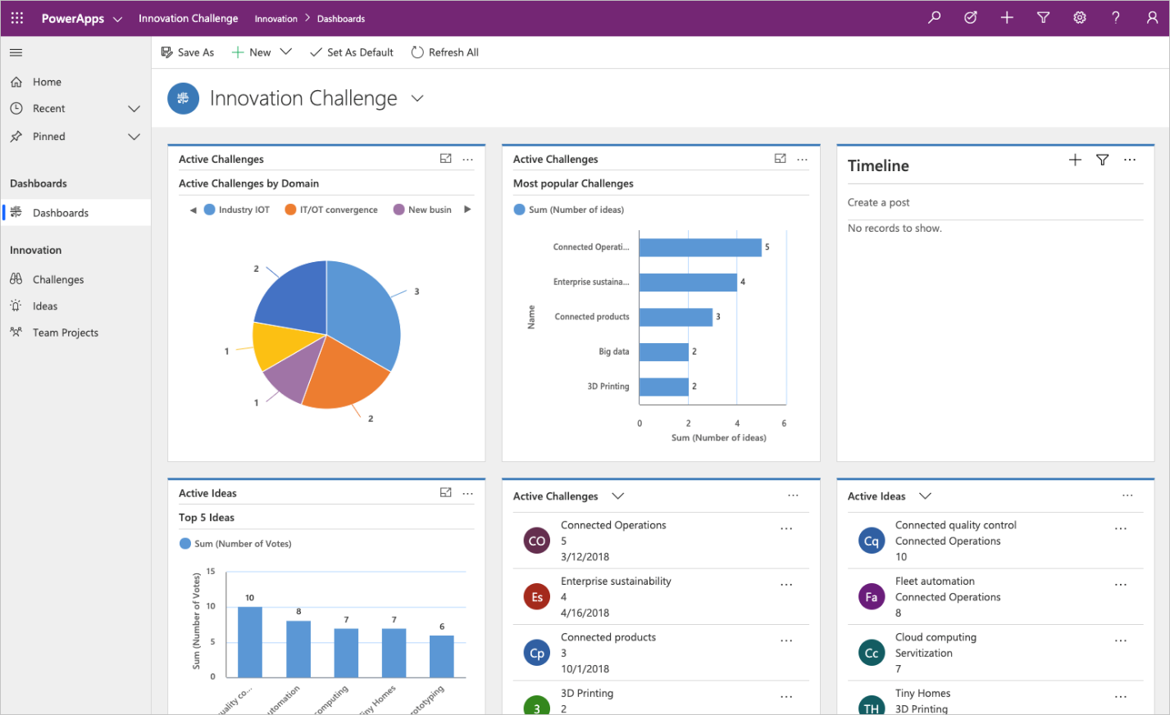
Model-driven apps
Model-driven app design is a component-focused approach to app development, and it does not require code, and the apps you make can be simple or very complex.
The approach to making model-driven apps:
Model your business data
Define your business processes
Build the app
Notes:
Model-driven app design is a component-focused approach to app development. Model-driven app design does not require code, and the apps you make can be simple or very complex. Unlike canvas app development, where the designer has complete control over app layout, much of the layout is determined for you with model-driven apps and largely designated by the components you add to the app.
Model your business data
Model-driven design uses metadata-driven architecture so that designers can customize apps without writing code. To model business data, you determine what data the app will need and how that data will relate to other data. Metadata means data about data and defines the structure of the data stored in Dataverse.
Define your business processes
Defining and enforcing consistent business processes is a key aspect of model-driven app design. Consistent processes help ensure that your app users can focus on their work and not worry about having to remember to perform a set of manual steps. Processes can be simple or complex, and they often change over time.
Build the app
After modeling data and defining processes, you build your app by selecting and setting up the components you need in the App Designer.

Slide 50




Building blocks of model-driven apps
Data
Tables
Columns
Relationships
User interface
App
Site map
Forms
Views
Logic
Business
process flows
Workflows
Actions
Business rules
Flows
Visualization
Charts
Dashboards
Embedded Power BI
Notes:
A model-driven app consists of several components that you select by using the App Designer. The components and component properties become the metadata. These components includes:
Data
Different data components that can make up a model-driven app which can determine what data the app:
Tables
Columns
Relationships
User interface
The user interface components which determine how users will interact with the app and what designer is used to create or edit the component.
App
Site map
Forms
Views
Logic
The logic components determine what business processes, rules, and automation the app will have. Logic types:
Business process flows
Workflows
Actions
Business rules
Flows
Visualization
The visualization components determine what type of data and reporting the app will show and have available and which designer is used to create or edit that component.
Charts
Dashboards
Embedded Power BI

Slide 51
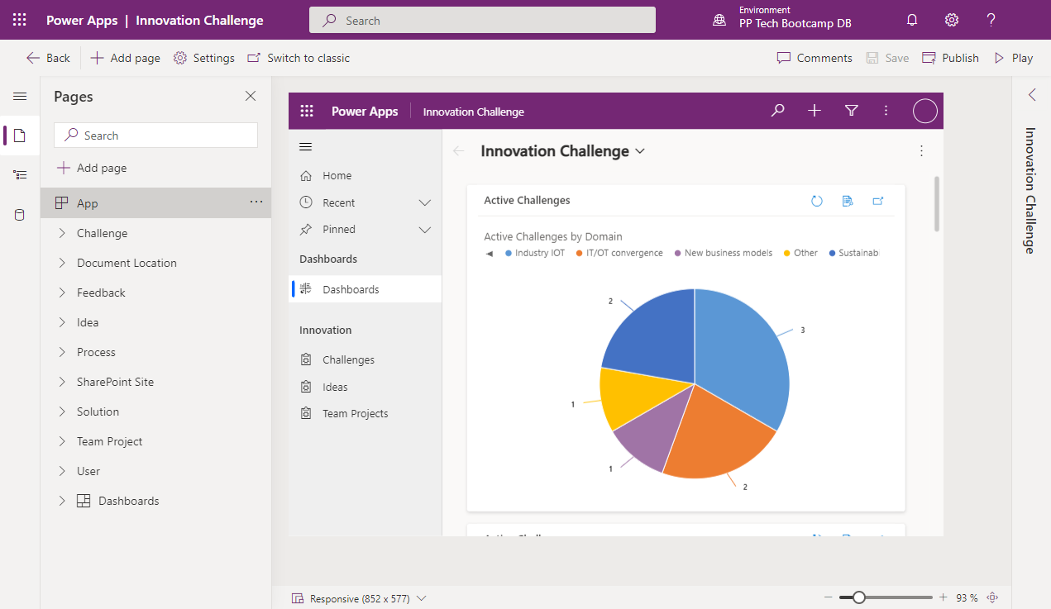
Design of model-driven apps
Notes:
Forms
Defining how users will see and interact with the data
Views
A list view of the rows for each table
Charts
Showing the data in a meaningful, visual representation
Dashboards
Providing an insightful, graphical overview of the data
Data Model
View the app metadata
View the app in Play mode
Business Logic
Set Business Rules
Build Business Process Flows
Dashboards
Implement Dashboards with custom filters and visual graphics
Additional third-party solutions and app accelerators

Slide 52
Create a model-driven app
Open and add a view in the app designer
Create a model-driven app
Add components to your app
Add a column to your view in app designer
Create a form
Publish your app
Edit a form
Notes:
Create a model-driven app
Sign in to Power Apps by using your organizational account.
Select the environment you want, or go to the Power Apps admin center to create a new one.
On the Home page, select Model-driven app from blank.
Click Create.
On the Create a New App page, enter a name and description for the app.
Select Done. Your new app appears in the App Designer, and you can now add components to it.
Add components to your app
You add components to your app by using the App Designer.
Select the Open the Site Map Designer pencil icon to open the site map designer.
In the site map designer, select New Subarea, and then, in the right pane on the Properties tab, select the following properties:
Type: Entity
Table (Entity): Account
Select Save And Close.
In the App Designer, select Forms, and then, in the right pane under Main Forms, select the Account form.
In the App Designer, select Views, then select the following properties:
Active Accounts
All Accounts
My Active Accounts
In the App Designer, select Charts, then select the Accounts by Industry chart.
On the App Designer toolbar, select Save.
Create a form
On the left navigation pane, expand Data, and then select Tables.
Select a table, such as the account table, and then select the Forms tab.
Select Add form, and then select one of the following
Main form The contents of the new form are filled using the existing main form definition. If multiple main forms exist, the form at the top of the list in the form order is used to fill the new form.
Quick create form
Quick view form
When you are done making changes to the form, select Save to save the form.
Edit a form
On the left navigation pane, expand Data, and then select Tables.
Select a table, such as the account table, and then select the Forms tab.
Select the form name that you want to edit.
You can also select the row for a form, and then in the command bar, select Edit form
Another alternative is to select ... next to the form name, and then in the menu, select Edit form.
When you are done making changes to the form, select Save to save the form.
Open and add a view in the app designer
The following steps explain how to open and add a view in the app designer.
In the app designer Table View (Entity View) section, select Views.
In this example, we have selected Views from the Account table.
To add a view, select it by using view types such as Public, Advanced Find, Associated, and Lookup. The view is automatically added to the Views list.
[!NOTE] Views are displayed based on the table that you have selected. For example, when you select Account, views that are related to the Account table are displayed.
For more information about the app designer visit Design custom business apps by using the app designer
Add a column to your view in app designer
Views display records in a table that contains rows and columns. Each row is a record, and the fields you display from the record are determined by the columns you add to the view.
In app designer, select the entity view that you want and then on the right pane next to the view that you want select edit (pencil button).
On the Components tab, select the Column Attributes list for either the Primary Table or Related Table.
From the list, select the column you want and drag it to the column heading. You can also add the column by double-clicking it.
Repeat step 3 until you have added all the columns you want to display in your view.
As you add attributes, you can drag them to any position among existing column headings. You can also move columns around after you add them to your view.
For more detailed options on creating and editing views visit https://docs.microsoft.com/en-us/powerapps/maker/model-driven-apps/create-edit-views-app-designer
Publish your app
On the App Designer toolbar, select Publish. After you publish the app, it is ready for you to run or share with others.
Above My Active Accounts, select Show Chart.
If the sample data for your accounts does not have an Industry populated, go into a few accounts and add an Industry. Once you have updated a few accounts with an industry, the chart will update as well.

Slide 53
Module 3
Lab 2: How to build a model-driven app

Slide 54
Module 4: Power Automate overview

Slide 55
Lesson introduction
In this lesson, you will:
Learn the business value and features of Power Automate
See how Power Automate works and looks from a user’s perspective
Notes:
Important Note: You may have previously known Power Automate as Microsoft Flow. In October of 2019 Microsoft Flow was renamed to Power Automate to better convey the fact the service is able to more than just create workflows. You will see that you still use Power Automate to create flows. This note is here as you will see some confusion in legacy content around Microsoft Flow and flow.

Slide 56
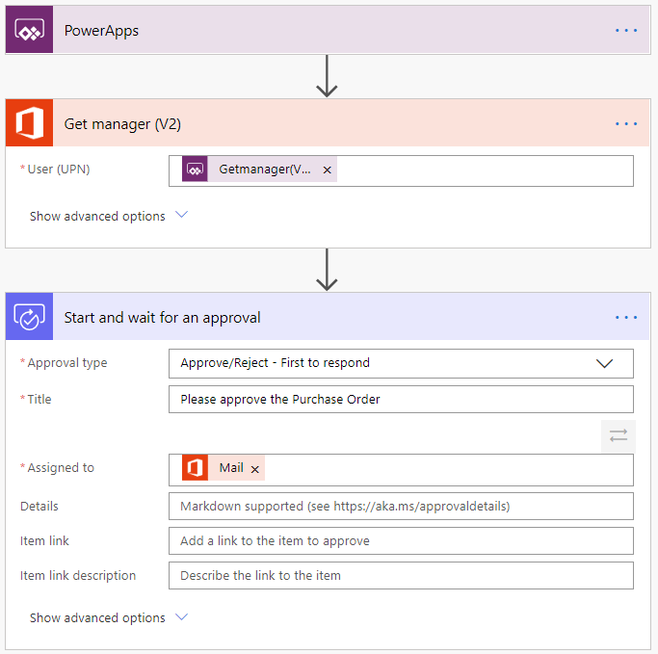
The value Power Automate brings
Common scenarios and capabilities:
Automating repetitive tasks
Guiding a user through a process
Connecting to external data sources
Automating desktop-based processes
Notes:
Do you find yourself downloading email attachments and then uploading the file to the database? Power Automate can help. Does the process of getting a new purchase order approved involve you taking a form from desk to desk to get sign off? Power Automate can help. Do you have to log into a website every morning, find the daily numbers, and then save those into another system? Power Automate can help.
Power Automate is all about having computers manage repetitive tasks. Power Automate allows anyone with knowledge of the business process to create a repeatable flow that when triggered, leaps into action and performs the process.
Common scenarios and capabilities of Power Automate:
Automating of repetitive tasks like moving data from one system to another
Guiding a user through a process so they can complete the different stages
Connecting to external data sources via one of the hundreds of connectors or directly via an API
Automating desktop based processes with robotic process automation (RPA) capabilities
Will dive into the example flow in next slides

Slide 57
Scale automation efficiently
Pre-built templates:
Build automated workflows using prebuilt templates and tailored automations
Automate across your favorite apps and services (600+ connectors):
Scale to automate across your favorite apps and services
Integrates with the Microsoft ecosystem:
Integrate with Azure, Microsoft 365, and Dynamics 365
On-premises and in the cloud:
Access and integrate data across on-premises software and cloud services
Notes:
Manual, repetitive, and error-prone tasks are a drag on the strategic thinking needed to drive my business forward. To improve business processes, organizations need an efficient way to scale automation across my organization.

Slide 58
Example: A purchase order approval
Approvals are a great process to build in Power Automate. They are often – defined yet manual. Check out the following scenario for an example:
A user starts the process by going into a Power Apps app and creating a purchase order request. Once they submit the request the information is sent to a Power Automate flow
The flow can be built to evaluate the request and then route the request based on criteria such as submitting user and request amount. The first action could be to send the request to the user’s manager. The manager could be automatically retrieved from Azure AD avoiding prompting for duplicate information

Slide 59
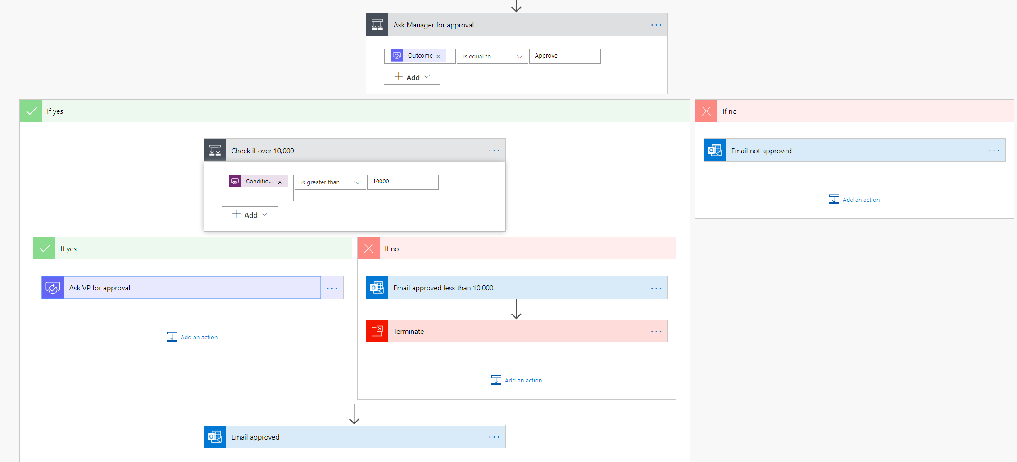
Example: A purchase order approval – continued
After the manager receives the approval and approves, the flow can then provide conditional logic. Typically this might be something like if the purchase order request is greater than $10,000 send it to VP if not then automatically approve the purchase order
Here is an example of what this flow may look like
Notes:
As you can see even the business process has many decision points. Your flow easily handles the decisions without you writing any code.

Slide 60
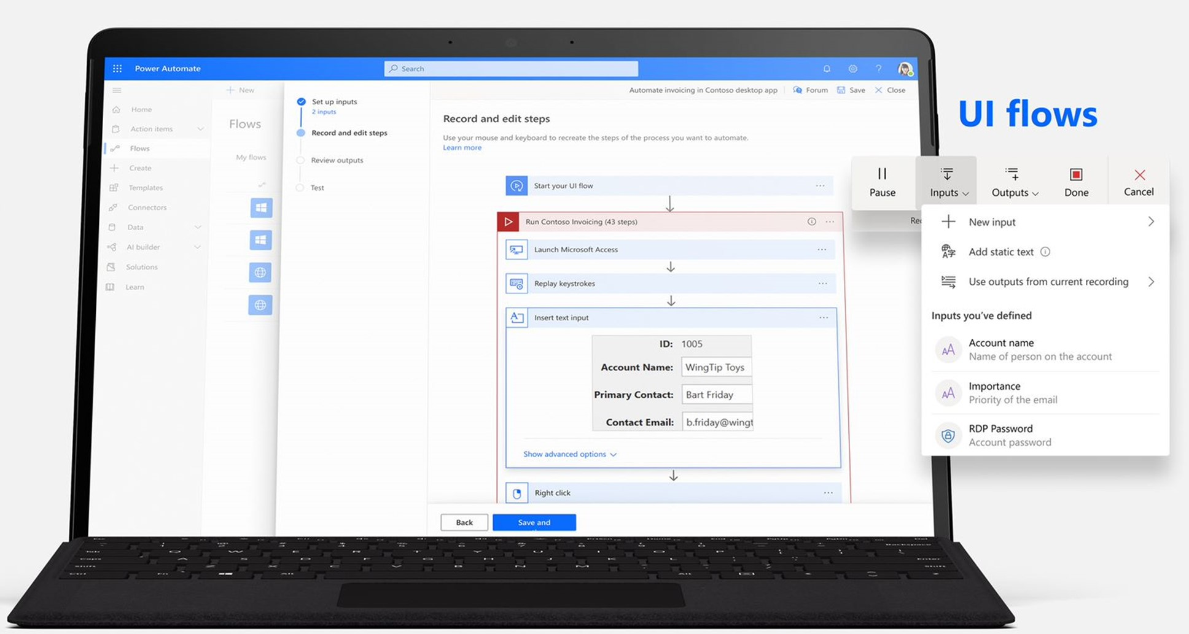
The three types of flows you can create with Power Automate
Power Automate works by creating flows, of which there are three types:
Cloud flows
Business process flows
Desktop flows
Notes:
Power Automate works by creating flows, of which there are three types:
Cloud flows- These are flows that you build with a trigger and then one or more actions. There are a multitude of triggers and actions available, thanks to the existing connectors. You will see these as My flows and Team flows in Power Automate. The only difference between a My flow and a Team flow is ownership. With a My flow you are the sole owner, while a Team flow has more than one owner.
Business process flows - These flows are built to augment the experience when using Model-driven apps and Dataverse. Use these to create a guided experience in your Model-driven apps.
Desktop flows – Formerly known as UI flows. These robotic process automation (RPA) flows allow you to record yourself performing actions on your desktop or within a web browser. You can then trigger a flow to perform that process for you. You can also pass data in or get data out of the process, letting you automate even "manual" business processes.

Slide 61
Add artificial intelligence to your flow without writing code
To take advantage of these AI capabilities you must first build a model. From make.powerapps.com a wizard guides you through building and training the model. Currently, there are four available AI models available to build:
Form processor:
This model extracts text from an uploaded image or taken photo
Object detector:
This model identifies objects from an uploaded image or taken photo and then provides a count of the number objects present
Prediction:
This model predicts whether something will happen or not based on previous data history. More details in the following section
Text classification:
This model categorizes text by its meaning, making it is easier to analyze

Slide 62
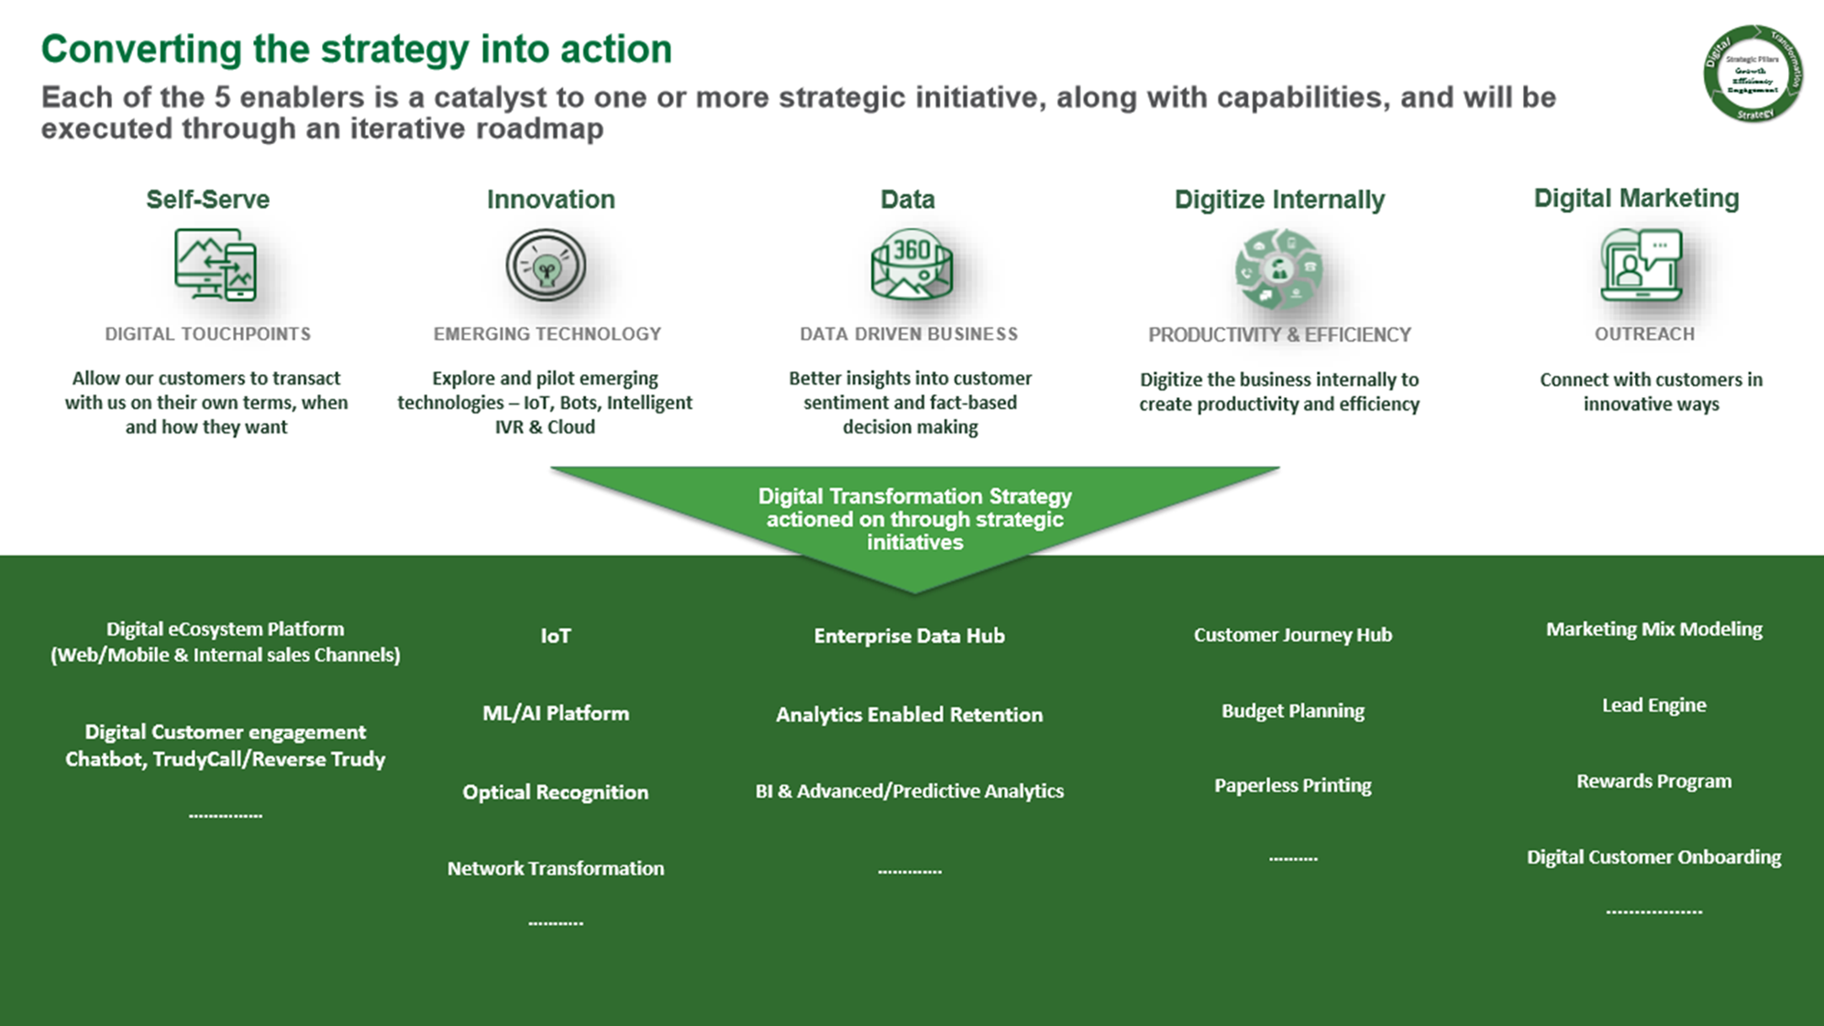
Customer case study: TruGreen
See full TruGreen case study here.
Notes:
This slide shows an infographic of their digital transformation strategy.
To provide better services they built a new artificial intelligence enabled virtual agent bot. The virtual agent was built without writing any code and instead used Power Virtual Agents to faciliate handling routine customer requests and to take action based on customer intent. To expose and interact with the back end data required they used Power Automate.
Tru Green used some of the hundreds of connectors avaiable for Microsoft Power Platform to connect to traditional data sources. Using these capabilities they had their first protype running in two days, once again without a single line of code.
In addition they had systems that didn't have APIs to be used by the connectors. For these systems they leveraged desktop flows. With desktop flows they were able to mimic onscreen actions that customer service associates used to perform manually via robotic process automation (RPA).
Now they have a fully functional virtual agent for interacting with their customers that can take action on the customers' intent in a meaningful way. This is just the first step as they continue to drive better customer experiences and more business value using these tools.
To read more about the virtual agents TruGreen has built and what they have planned next please see the full case study here: https://customers.microsoft.com/en-us/story/759484-trugreen-partner-professional-services-power-virtual-agents
In the next unit, you will get an overview of some of these solutions in Power Automate and learn how you can get started with building your own flows.

Slide 63
Power Automate in action
Demo: Create a flow with Power Automate
Notes:
A video demo is available at the following link: https://www.microsoft.com/en-us/videoplayer/embed/RE4mERh

Slide 64
How to build an automated solution

Slide 65
Introduction to Automation
In this lesson, you will:
Create a flow from a template
Create a recurring flow on a schedule
Create a flow triggered by a button
Automate an approval request and discover the approval center

Slide 66
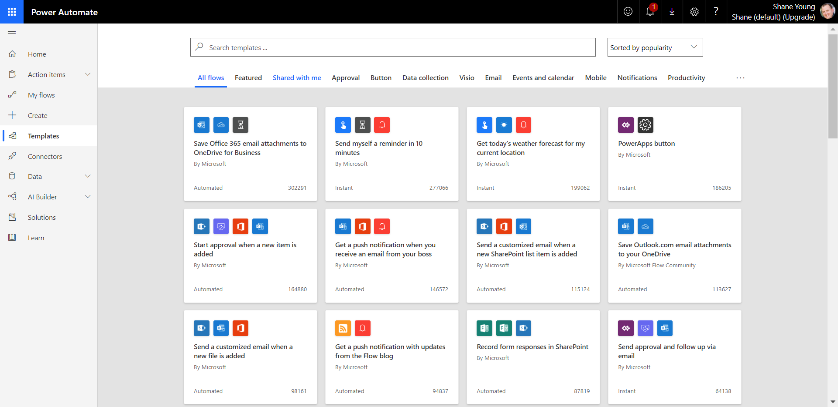
Create a flow from a template
Search using keywords for relevant templates
Example template: Create a flow to save email attachments to OneDrive for Business
Notes:
With the hundreds of triggers, actions and connectors, sometimes the hardest part about Power Automate can be figuring out where to get started. To help you get started, there are countless flow templates available to help you build a solution. To see all of the available templates you can sign into Power Automate , and select Templates from the left-hand menu.
From here, you can search by a specific word or phrase like "Common Data Service" (Dataverse) or you can browse based on category.
If you click on a specific template, you will see details about the template including the data sources it will connect to.
Create a flow to save email attachments to OneDrive for Business
From the list of templates search for "Save Office 365 email attachments to OneDrive for Business" and then click on the template to start using it.
Click Create Flow at the bottom of the screen to create the flow.

Slide 67
Important concepts in Microsoft Power Automate
Keep these concepts in mind when building flows:
Every flow has two main parts:
a trigger
one or more actions
Think of the trigger as the starting action for the flow
Actions are what you want to happen when a trigger is invoked.
Some examples of types of actions you can have in a flow include:
Loops
Switch
Do Until
Apply to each
Expressions
Notes:
Keep these concepts in mind when building flows:
Every flow has two main parts: a trigger, and one or more actions.
You can think of the trigger as the starting action for the flow. The trigger can be something like a new email arriving in your inbox or a new item being added to a SharePoint list.
Actions are what you want to happen when a trigger is invoked. For example, the new email trigger will start the action of creating a new file on OneDrive for Business. Other examples of actions include sending an email, posting a tweet, and starting an approval.
Some examples of types of actions you can have in a flow include:
Loops – Runs an action until conditions are met to move to the next step of the flow
Switch – Identifies a single case to execute based on the evaluation of input
Do Until – Executes a block of actions until a specified condition evaluates to true
Apply to each – Executes a block of actions for each item in the input array
Expressions – underlying definition that describes the actual logic that runs in your flow that can be manually written
You can also perform data operations in your flow, such as Compose, Create CSV table, Join, or Select. These concepts will come into play later when you build your own flows from scratch.

Slide 68
Trigger or run the flow
With Power Automate, you don’t think of running a flow the same way as you do with Power Apps. Instead, you perform the activity that triggers the flow to run.
When defining triggers, there are a few different types:
When something changes:
These are triggers that run when data is changed. It could be a new item created in SharePoint, a lead is updated in Dynamics, or when an event has been deleted from Outlook for example
On a schedule:
You can set up a flow to be triggered at a certain time of a day and with a recurrence. This allows for workflows such as checking every day at 8 AM if there are account renewals pending and if so, sending an email to the necessary people
On a button press:
This trigger takes shape in many different ways. This can be when a flow virtual button is run through the mobile app, or a physical button is clicked with 3rd party options, or even when a button is pressed inside of Power Apps. This gives you that control to “run” a flow on-demand
Notes:
With Power Automate, you do not think of running a flow the same way as you do with running a Power Apps app. Instead, you perform the activity that triggers the flow to run. In the case of the previous flow, instead of periodically running the flow manually, it would automatically run every time a new email is received with an attachment. This is because the flow has the trigger that determines when it should run.

Slide 69
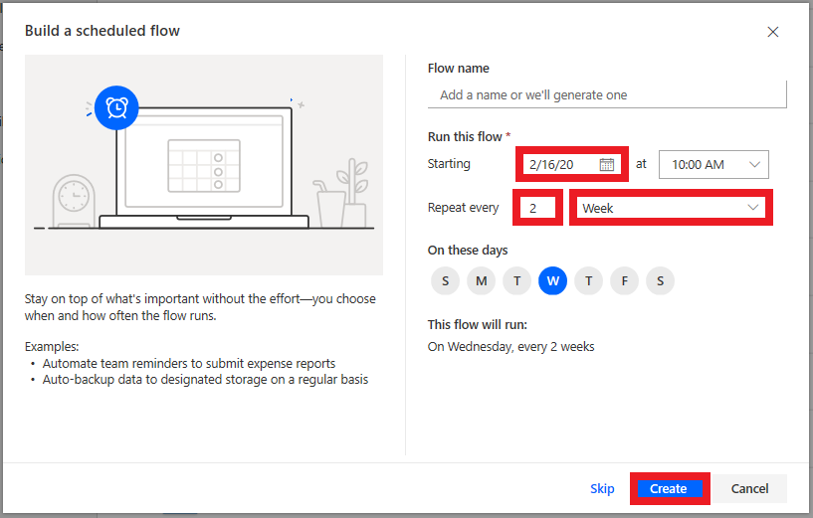
Scheduled flows
Scheduled flows can run:
Once a day, an hour, or a minute
On a date that you specify
After a number of days, hours, or minutes that you specify
Notes:
Create the flow:
For example, if you want the flow to run every two weeks, enter 2 in the Interval field, and select Week in the Frequency field. You can also specify the day of the week your flow should run. The text at the bottom of the dialog box explains your inputs in plain language.
Specify advanced options
For example, set up the flow as shown in the following graphic to start it no earlier than noon (Pacific time) on Monday, January 1, 2018, and to run it every two weeks, at 5:30 PM (Pacific time) on Tuesday.
Use the compose action
Use the Data Operation - Compose (compose) action to save yourself from entering identical data multiple times when you are designing a flow.
**Follow steps on Build recurring flows - Learn | Microsoft Docs to build a recurring flow (can do as demo or individual exercise)

Slide 70
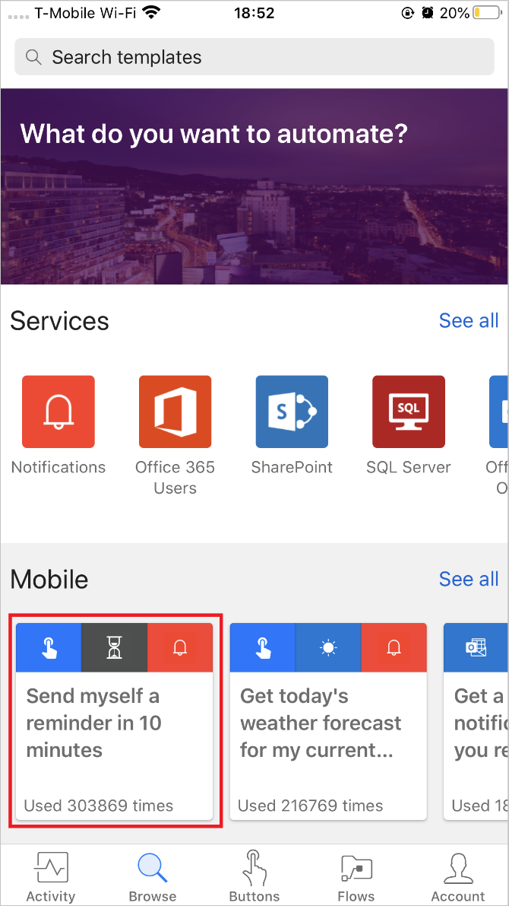
Button flows
Create a Flow using a button through the Power Automate mobile app
Activity Feed
Browsing
Buttons
Managing Flows
How button flows are started
Buttons are flows that are started through a manual action.
Notes:
Create a Flow using a button through the Power Automate mobile app
First, you'll need to download and install the Power Automate mobile app from your app store.
After it's installed, start it and sign in.
When you first start the app, you'll see the Activity Feed. The Activity Feed is the place to see what's happening with your flows. It won't be the full experience you'd expect from your PC, but it will show you useful details.
For example, you'll see a flow's last activity. You can see whether the flow succeeded or failed. If it failed, you'll see which step it failed on.
**Follow steps on Build a button flow - Learn | Microsoft Docs to build a button flow (can do as demo or individual exercise)

Slide 71
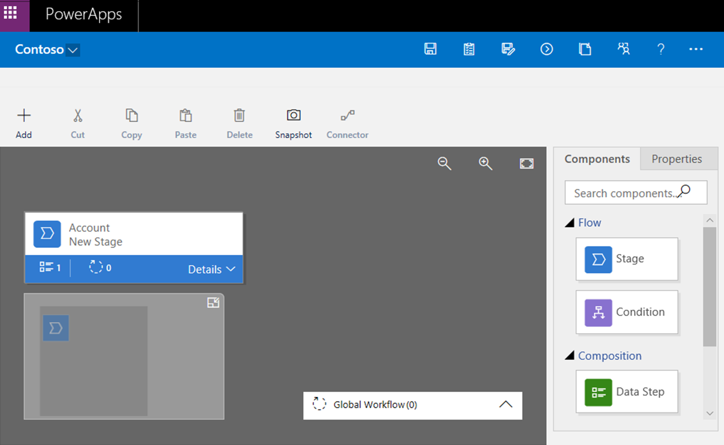
Understand business process flows
Used to guide a user through the steps of your business process when working with model-driven apps and Dataverse
Notes:
Stage Name: You can change the stage name after you create the stage.
Table (entity): You can change the table for any stage except the first one.
Stage Category: A category lets you group stages by the type of action. It's useful for reports that will group records by the stage that they're in. The options for the stage category come from the Stage Category global option set. You can add more options to this global option set and change the labels of existing options. You can also delete options, but we recommend that you keep the existing options. If you delete an option, you won't be able to add it back later. If you don't want an option to be used, change the label to Do not use.
Relationship: Enter a relationship when the preceding stage in the process is based on a different table than the current stage. For the current stage, select Select relationships, and then specify the relationship that should be used when the flow moves between the two stages. We recommend that you specify relationships, because they provide the following benefits:
Attribute maps are often defined for relationships. These attribute maps automatically carry over data between records. Therefore, they help minimize the amount data entry that's required.
When you select Next Stage on the process bar for a record, any records that use the relationship are listed in the process flow. Therefore, the reuse of records in the process is promoted. In addition, you can use workflows to automate the creation of records. Users then just have to select the workflow instead of creating a record. Therefore, the process is streamlined.
Set Process Flow Order: If you have more than one business process flow for a table (record type), you must specify which process is automatically assigned to new records. On the action bar, select Order Process Flow. For new records or records that don't already have a process flow associated with them, the first business process flow that a user has access to will be used.
Enable Security Roles: A user's access to a business process flow depends on the privileges that are defined for the business process flow in the security role that's assigned to the user. By default, only the System Administrator and System Customizer security roles can view a new business process flow.
**No exercise for this topic. Optional to perform a demo if time allows.

Slide 72

Module 4 lab
Lab 1: How to build an automated solution

Slide 73
Module 5: Power BI overview

Slide 74
Lesson introduction
In this lesson, you will:
Describe the business value and features of Power BI
See how Power BI works and looks from the user’s perspective
Notes:
The business world is increasingly data driven. Small and large businesses alike use data to make decisions about sales, hiring, goals, and all areas for which they have data. While most businesses have access to data of one type or another, it can be intimidating to try to understand without a background in data analytics or statistics. Even if you do understand the data, a challenge may arise in displaying the data in an easy to understand way and communicating it to other relevant people. Power BI takes the intimidation and hassle out of data analysis and visualization. By connecting to one or more of the hundreds of existing data sources and using a secure, easy to understand interface, you can quickly and simply interact with and understand your data to influence all business systems.

Slide 75
What is Power BI?
Self-service platform that helps you discover, analyze and visualize data in order to share and collaborate insights with your colleagues
Visualizations are interactive and scalable reports, based on collections of different data sources
https://dpspowerbi.blob.core.windows.net/powerbi-prod-media/powerbi.microsoft.com/en-us/documentation/articles/powerbi-learning-0-0-what-is-power-bi/20160929090613/c0a0_1.png
Notes:
Microsoft Power BI is a collection of software services, apps, and connectors that work together to turn your unrelated sources of data into coherent, visually immersive, and interactive insights.
Whether your data is a simple Microsoft Excel workbook, or a collection of cloud-based and on-premises hybrid data warehouses, Power BI lets you easily connect to your data sources, clean, and model your data without affecting the underlying source, visualize (or discover) what's important, and share that with anyone or everyone you want.

Slide 76
What is Power BI? - continued
Power BI concepts
Capacities:
Set of resources used to host and deliver content
Either shared or dedicated
Workspaces:
My workspace is for personal use
Workspaces are for collaboration and sharing
Datasets:
A collection of data that you import or connect to
Associated with workspaces
Shared Datasets:
Used to share optimized and accurate data
Provides data consistency to organizations
Reports:
One or more pages of visualizations
Two modes: Reading view & editing view
Dashboards:
Single canvas containing tiles and widgets
Easy viewing and monitoring
Notes:
Capacities
Capacities are a core Power BI concept representing a set of resources used to host and deliver your Power BI content. Capacities are either shared or dedicated. A shared capacity is shared with other Microsoft customers, while a dedicated capacity is fully committed to a single customer. Dedicated capacities require a subscription. By default, workspaces are created on a shared capacity.
Workspaces
Workspaces are containers for dashboards, reports, datasets, and dataflows in Power BI. There are two types of workspaces: My workspace and workspaces.
My workspace is the personal workspace for any Power BI customer to work with your own content. Only you have access to your My workspace. You can share dashboards and reports from your My Workspace. If you want to collaborate on dashboards and reports, or create an app, then you want to work in a workspace.
Workspaces are used to collaborate and share content with colleagues. You can add colleagues to your workspaces and collaborate on dashboards, reports, and datasets. With one exception, all workspace members need Power BI Pro licenses.
Workspaces are also the places where you create, publish, and manage apps for your organization. Think of workspaces as staging areas and containers for the content that will make up a Power BI app. So what is an app? An app is a collection of dashboards and reports built to deliver key metrics to the Power BI consumers in your organization. Apps are interactive, but consumers cannot edit them. App consumers, the colleagues who have access to the apps, do not necessarily need Pro licenses.
Datasets
A dataset is a collection of data that you import or connect to. Power BI lets you connect to and import all sorts of datasets and bring all of it together in one place. Datasets can also source data from dataflows.
Shared Datasets
Business intelligence is a collaborative activity. It's important to establish standardized datasets that can be the 'one source of truth.' Discovering and reusing those standardized datasets is key. When expert data modelers in your organization create and share optimized datasets, report creators can start with those datasets to build accurate reports. Your organization can have consistent data for making decisions, and a healthy data culture.
Reports
A Power BI report is one or more pages of visualizations such as line charts, maps, and treemaps. Visualizations are also called visuals. You can create reports from scratch within Power BI, import them with dashboards that colleagues share with you, or Power BI can create them when you connect to datasets from Excel, Power BI Desktop, databases, and SaaS applications.
When you open a report, it opens in Reading view. If you have edit permissions, then you see Edit report in the upper-left corner, and you can view the report in Editing view.
When you open a workspace, the associated reports are listed under the Reports tab. Each listed report represents one or more pages of visualizations based on only one of the underlying datasets. To open a report, select it.
When you open an app, you are presented with a dashboard. To access an underlying report, select a dashboard tile (more on tiles later) that was pinned from a report. Keep in mind that not all tiles are pinned from reports, so you may have to click a few tiles to find a report.
Dashboards
A dashboard is something you create in the Power BI service or something a colleague creates in the Power BI service and shares with you. It is a single canvas that contains zero or more tiles and widgets. Each tile pinned from a report or from Q&A displays a single visualization that was created from a dataset and pinned to the dashboard. Entire report pages can also be pinned to a dashboard as a single tile. There are many ways to add tiles to your dashboard; too many to be covered in this overview topic.

Slide 77
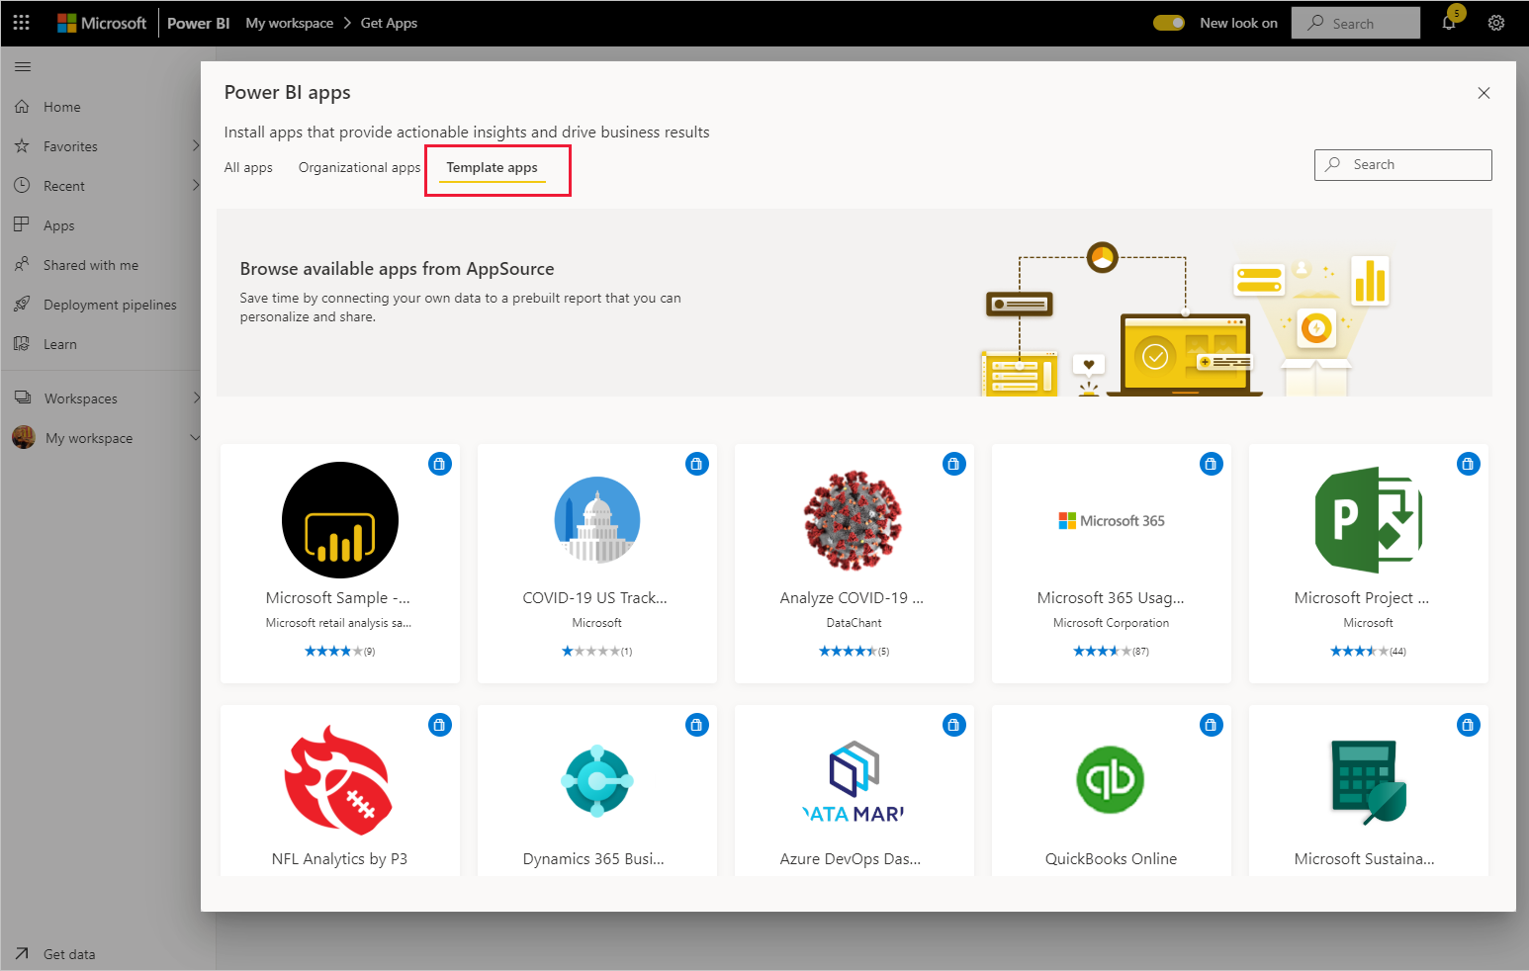
Template Apps
Definition
The new Power BI template apps enable Power BI partners to build Power BI apps with little or no coding and deploy them to any Power BI customer.
As a Power BI partner, you create a set of out-of-the-box content for your customers and publish it yourself.
You can build template apps that allow your customers to connect within their own accounts.
Notes:
Install a template app:
In the nav pane in the Power BI service, select Apps > Get apps.
In the Power BI apps marketplace that appears, select Template apps. All the template apps available in AppSource will be shown. Browse to find the template app you're looking for, or get a filtered selection by using the search box.
When you find the template app you're looking for, click it. The template app offer will display. Click GET IT NOW.
In the dialog box that appears, select Install.

Slide 78
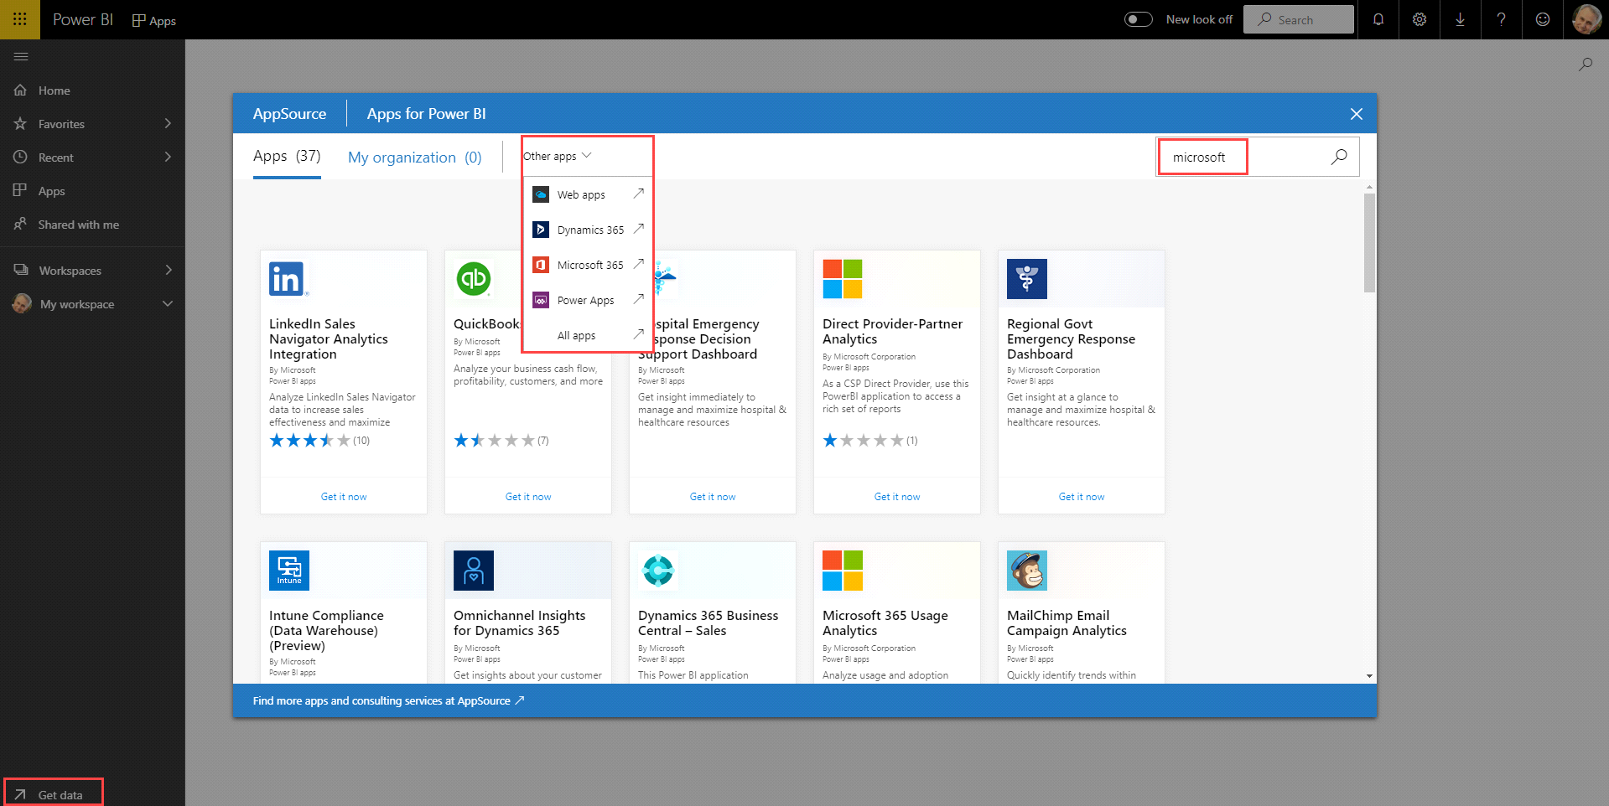
Getting Data
Excel files
Databases
Azure data
AppSource
Dynamics 365
SaaS providers
Salesforce
Facebook
Google Analytics
other SaaS services
Notes:
Microsoft Power BI is a collection of software services, apps, and connectors that work together to turn your unrelated sources of data into coherent, visually immersive, and interactive insights.
Whether your data is a simple Microsoft Excel workbook, or a collection of cloud-based and on-premises hybrid data warehouses, Power BI lets you easily connect to your data sources, clean, and model your data without affecting the underlying source, visualize (or discover) what's important, and share that with anyone or everyone you want.

Slide 79
Power BI Tools
Desktop
Mobile
Service
Notes:
Connect to sources
Prepare data sets for analysis
Transform and Cleanse
Create reports for consumption

Slide 80
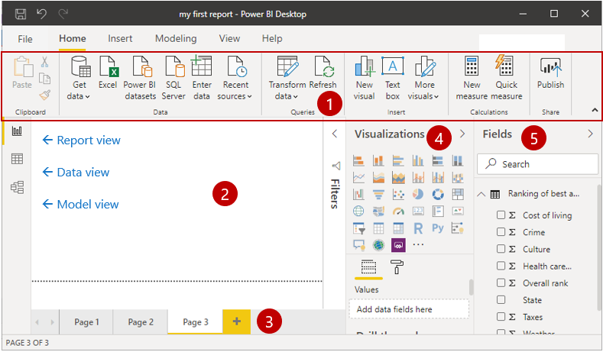
Data modeling and visualizations
In Power BI Desktop, you will begin to build reports in the Report view. You will be working in five main areas:
Ribbon
Report view, or canvas
Pages tab
Visualizations pane
Fields pane
Notes:
Ribbon - Displays common tasks that are associated with reports and visualizations.
Report view, or canvas - Where visualizations are created and arranged.
The Data view allows you to view all of your data available in your report. This is an easy way to quickly check data types and validate data.
The Model view allows you to visually set the relationship between tables or elements. A relationship is where two or more tables are linked together because they contain related data. This enables users to run queries for related data across multiple tables.
Pages tab - Located along the bottom of the page, this area is where you would select or add a report page.
Visualizations pane - Where you can change visualizations, customize colors or axes, apply filters, drag fields, and more.
Fields pane - Where query elements and filters can be dragged onto the Report view or dragged to the Filters area of the Visualizations pane.

Slide 81
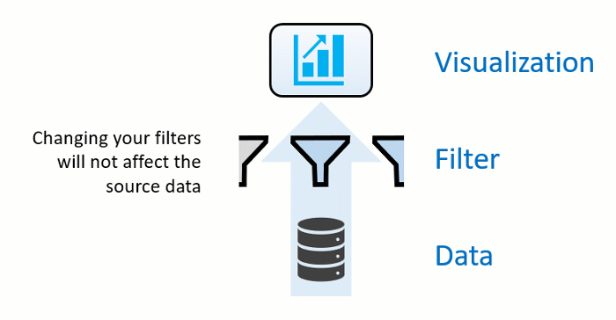
Filter data with Power BI
Slicers:
A simple type of filtering that you can use directly on the report page. Slicers provide cues to ways you can filter the results in the visuals on a report page.
Four types of filters:
Report
Page
Visual
Drillthrough
Notes:
Power BI offers several ways to filter and highlight reports. Knowing how to filter data is the key to finding the right information.
Note:
Filtering only applies to reports, not to dashboards.
When you filter a visual like a bar chart, you are just changing the view of the data in that visual. You are not modifying the source data in any way.
Slicers
There are several different types of slicers: numeric, categorical, and date. Slicers make it easy to filter all the visuals on the page at once.
The four types of filters are:
Report – Applies to all pages in the report.
Page – Applies to all the visuals on the current report page.
Visual – Applies to a single visual on a report page. You only see visual level filters if you have selected a visual on the report canvas.
Drillthrough – Allows you to explore successively more detailed views within a single visual.

Slide 82
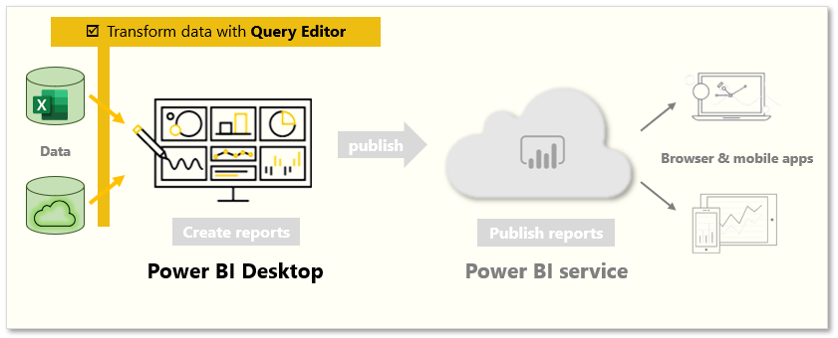
Transform data
Launch Power Query Editor
Select Edit from the Navigator window
Using the Edit Queries button on the Home ribbon from Power BI Desktop
How to transform data
On the center pane, right-clicking a column displays the available transformations
Notes:
Sometimes, your data might contain extra data or have data in the wrong format. Power BI Desktop includes the Power Query Editor tool, which can help you shape and transform data so that it's ready for your models and visualizations.
Launch Power Query Editor
To begin, select Edit from the Navigator window to launch Power Query Editor. You can also launch Power Query Editor directly from Power BI Desktop by using the Edit Queries button on the Home ribbon.
After loading your data into Power Query Editor
In the ribbon, the active buttons enable you to interact with the data in the query.
On the left pane, queries (one for each table, or entity) are listed and available for selecting, viewing, and shaping.
On the center pane, data from the selected query is displayed and available for shaping.
The Query Settings window lists the query’s properties and applied steps.
How to transform data
On the center pane, right-clicking a column displays the available transformations. Examples of the available transformations include removing a column from the table, duplicating the column under a new name, or replacing values. From this menu, you can also split text columns into multiples by common delimiters.
The Power Query Editor ribbon contains additional tools that can help you change the data type of columns, add scientific notation, or extract elements from dates, such as day of the week.
Tips:
If you make a mistake, you can undo any step from the Applied Steps list.
As you apply transformations, each step appears in the Applied Steps list on the Query Settings pane. You can use this list to undo or review specific changes, or even change the name of a step. To save your transformations, select Close & Apply on the Home tab.
While Power BI can import your data from almost any source, its visualization and modeling tools work best with columnar data. Sometimes, your data won't be formatted in simple columns, which is often the case with Excel spreadsheets.
How to clean data
Fortunately, Power Query Editor has tools to help you quickly transform multi-column tables into datasets that you can use.
Transpose data
By using Transpose in Power Query Editor, you can swap rows into columns to better format the data.
Format data
You might need to format data so that Power BI can properly categorize and identify that data. With some transformations, you'll cleanse data into a dataset that you can use in Power BI. Examples of powerful transformations include promoting rows into headers, using Fill to replace null values, and Unpivot Columns.
With Power BI, you can experiment with transformations and determine which will transform your data into the most usable columnar format. Remember, the Applied Steps section of Power Query Editor records all your actions. If a transformation doesn't work the way that you intended, select the X next to the step, and then undo it.
After you've cleaned your data into a usable format, you can begin to create powerful visuals in Power BI.
For more information, see Tutorial: Combine sales data from Excel and an OData feed .

Slide 83
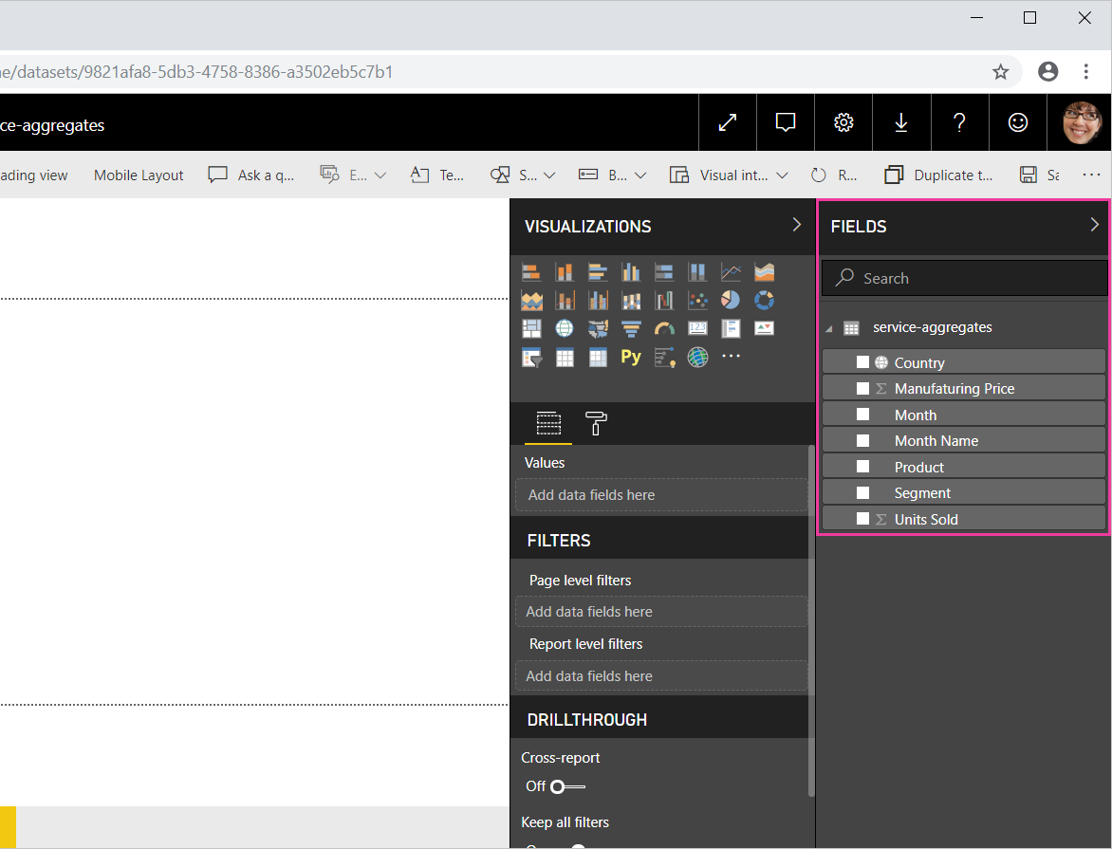
Work with aggregates in the Power BI service
When you combine values in your data, it's called aggregating. The result of that mathematical operation is an aggregate.
Ways to aggregate your data
- Do Not Summarize
- Sum
- Average
- and more
Notes:
What is an aggregate?
Sometimes you want to mathematically combine values in your data. The mathematical operation could be sum, average, maximum, count, and so on. When you combine values in your data, it's called aggregating. The result of that mathematical operation is an aggregate.
When Power BI service and Power BI Desktop create visualizations, they may aggregate your data. Often the aggregate is just what you need, but other times you may want to aggregate the values in a different way. For example, a sum versus an average. There are several different ways to manage and change the aggregate Power BI uses in a visualization.
First, let's take a look at data types because the type of data determines how, and whether, Power BI can aggregate it.
Why don't aggregates work the way I want them to?
Working with aggregates in Power BI service can be confusing. Maybe you have a numeric field and Power BI won't let you change the aggregation. Or maybe you have a field, like a year, and you don't want to aggregate it, you just want to count the number of occurrences.
Typically, the underlying issue is the field definition in the dataset. Maybe the dataset owner defined the field as text and that explains why Power BI can't sum or average it. Unfortunately, only the dataset owner can change the way a field is categorized . So if you have owner permissions to the dataset, either in Desktop or the program used to create the dataset (for example, Excel), you can fix this problem. Otherwise, you'll need to contact the dataset owner for help.

Slide 84
Customer case study: Miami Heat
Using Power BI and the entire Azure data platform, we can predict attendance for all 44 games of the season within hours of the schedule being released
– Edson Crevecoeur, Vice President of Strategy and Data Analytics for the Miami Heat
Notes:
A video demo is available at the following link: https://www.microsoft.com/en-us/videoplayer/embed/RE4miHj
While it's accepted that data can improve business processes and increase revenue, a real-world example helps to unite the concepts that we've already covered and allows you to see the potential of Power BI in action. One such case is that of Miami heat, whose Power BI adoption is 70% across the organization.
Miami Heat leveraged the powerful analysis and visualization features to completely transform their customer interactions and business operations.

Slide 85

Power BI in action
Demo: How to get started with Power BI
Notes:
A video demo is available at the following link: https://www.microsoft.com/en-us/videoplayer/embed/RE4mERi

Slide 86
Build a simple dashboard with Power BI

Slide 87
Lesson introduction
Learn to connect to data in Power BI desktop
Transform and model the data you import
Build basic visualizations
Create and share a dashboard
Discover how to collaborate in Power BI
Notes:
We all live in a data culture where business decisions are based on facts, not opinions. We need data to help us make these decisions. Power BI Desktop is a free application for PCs that lets you gather, transform, and visualize your data. Power BI Desktop and the Power BI Service work together. You can create your reports and dashboards in Power BI Desktop and then publish them to the Power BI Service for others to consume.

Slide 88
Exercise 1: Build a dashboard
Follow the instructions from the following list:
Objectives of this exercise are:
Connect to data
Transform and Model data
Visualize data
Build a dashboard
Collaborate and share
Notes:
Allow students to do the exercises or walk them through this exercise as group activity.
As an alternative, change the title from Exercise to Demo and demo it for delegates.
A video demo is also available at the following link: https://www.microsoft.com/en-us/videoplayer/embed/RE4mERi

Slide 89
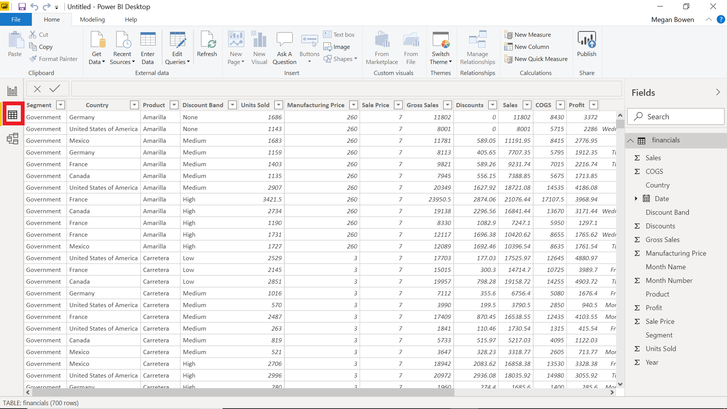
Connect to data
Notes:
Connect to data
Power BI Desktop connects to many types of data sources, including local databases, worksheets, and data on cloud services. Sometimes when you gather data, it's not quite as structured, or clean, as you want it to be. To structure data, you can transform it, meaning that you can split and rename columns, change data types, and create relationships between columns.
You can connect Power BI Desktop to many types of data sources, including on-premises databases, Microsoft Excel workbooks, and cloud services. Currently, there are over 110 Power BI-specific connectors to cloud services such as GitHub and Marketo. You can also connect to generic sources through XML, CSV, text, and ODBC. Power BI will even extract tabular data directly from a website URL.
Instructions: https://docs.microsoft.com/en-us/learn/modules/build-simple-dashboard/2-connect-data

Slide 90
Transform data
Create new calculated column
Hide unnecessary columns
Explore edit queries, report building, and relationship tabs
Notes:
Data doesn't always come into your report clean, or ready to use. You may need additional columns or to rename or hide existing columns. You may have multiple data sources and need to define a relationship between them. All of these tasks are known as data transformation.
Instructions: https://docs.microsoft.com/en-us/learn/modules/build-simple-dashboard/3-transform-data

Slide 91
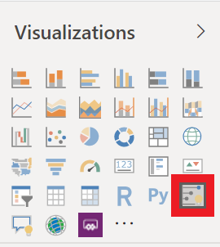
Visualize data
Drag field names from Fields pane and drop into report canvas
In Visualizations pane, select type of visualization you want to create
Notes:
Two ways to create a new visualization in Power BI Desktop are:
Drag field names from the Fields pane and then drop them on the report canvas. By default, your visualization appears as a table of data.
In the Visualizations pane, select the type of visualization that you want to create. With this method, the default visual is a blank placeholder that resembles the type of visual that you selected.
Now that we've learned how to craft simple visuals, go ahead and create a few more to test your new skills and better learn how Power BI works. Finally, save your report locally and select Publish on the Home tab. You can publish this to My Workspace, which is the default for all new accounts. This step is necessary in order to create a dashboard. Once you have published your report, you will have the option to open your report in Power BI, go ahead and do so.
Instructions: https://docs.microsoft.com/en-us/learn/modules/build-simple-dashboard/4-visualize-data

Slide 92
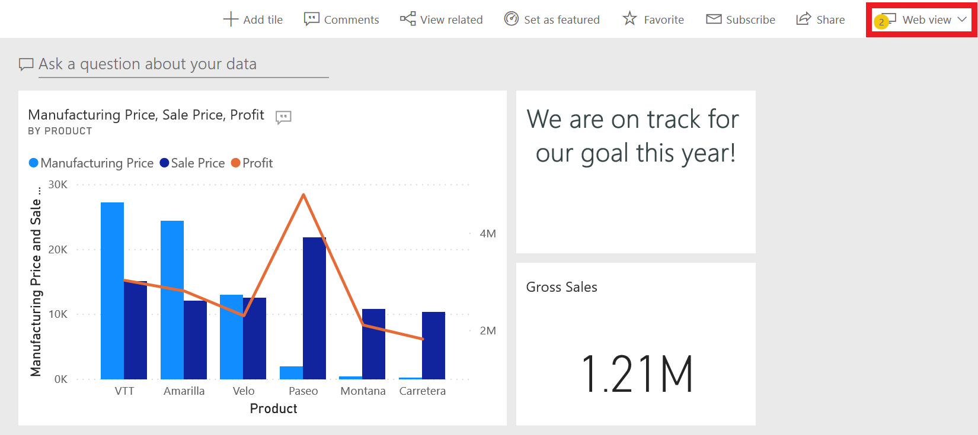
Build a dashboard
Dashboard:
One-page visualization created from within Power BI service (online)
Pin visuals from reports to create dashboards
Notes:
Up to this point we have been working in Power BI Desktop. Dashboards in Power BI are one-page collections of visualizations that are created from within the Power BI service (online). You can create dashboards by pinning visuals from reports.
If you clicked on the link from publishing your report, your report should now be open in your browser. Let's use this report to create a dashboard.
Instructions: https://docs.microsoft.com/en-us/learn/modules/build-simple-dashboard/5-build-dashboard

Slide 93
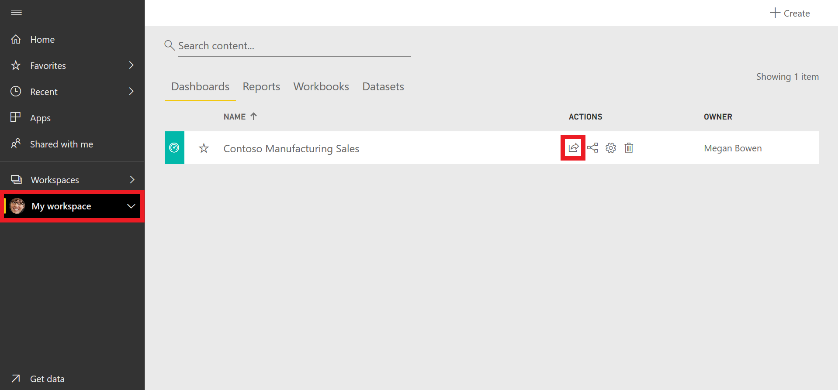
Collaborate and share
Tip:
If you are unable to share with a colleague, you may need to check you and your colleague’s licensing.
Notes:
Students will probably not be able to do this step. It is good to highlight why – licensing. They need Power BI Pro licenses to do this.
Power BI service makes it easy to share your datasets, dashboards, and reports with your colleagues. Power BI simplifies collaboration and improves the outcome by allowing you and your colleagues to work simultaneously on the same dashboards and reports. And, while you and your colleagues explore the data and make changes to the reports and dashboards, the underlying data is not affected.
Instructions: https://docs.microsoft.com/en-us/learn/modules/build-simple-dashboard/6-collaborate-share

Slide 94

Module 5 lab
Lab 1: How to build a simple dashboard

Slide 95
Module 6: Power Virtual Agents overview

Slide 96
Lesson introduction
In this lesson, you will:
Learn how to describe the business value and features of Power Virtual Agents
Learn essential components that make up Power Virtual Agents and chatbots
Notes:
Power Virtual Agents are adaptable Artificial Intelligence (AI) chatbots, at your service. They can solve common customer and internal-facing issues automatically, freeing up staff to focus on complex requests and high-value interactions. You can easily create your own virtual agents, powerful chatbots, without the need for developers or data scientists, by using a guided, no-code graphical interface. Integrate Power Virtual Agents with the products and services you use every day using hundreds of prebuilt connectors, by building custom workflows using Power Automate, or creating complex scenarios with Microsoft Bot Framework. Monitor and continuously improve chatbot performance using AI- and data-driven insights available in an easy-to-read dashboard.

Slide 97
Power Virtual Agents and what can it do for you
Power Virtual Agents can
Empower your teams
Reduce costs
Improve customer satisfaction
Highlights of Power Virtual Agents
Get started in seconds
Empower your subject matter experts.
Enable rich, natural conversations.
Enable chatbots to take action.
Monitor and improve chatbot performance.
Better together.
Notes:
Using Power Virtual Agents, you can:
Empower your teams by allowing them to easily build chatbots themselves without needing intermediaries, coding, or AI expertise.
Reduce costs by easily automating common inquiries and freeing human agent time to deal with more complex issues.
Improve customer satisfaction by allowing customers to self-help and resolve issues quickly, 24/7 using rich personalized bot conversations.
Get started in seconds. Power Virtual Agents is a software-as-a-service (SaaS) offering. It allows you to easily sign up, create your chatbot, and embed it into your website with just a few clicks. There is no infrastructure to maintain or complex systems to deploy.
Empower your subject matter experts. Using Power Virtual Agents, you are in the driver's seat. Your SMEs can create chatbots quickly and easily using a novel, intuitive, code-free graphical interface, eliminating the need for AI expertise or teams of developers.
Enable rich, natural conversations. Microsoft’s powerful conversational AI capabilities enable your end users to have rich multi-turn conversations that quickly guide them to the right solution. And, unlike most products on the market, there is no need to retrain AI models. Simply provide a few short examples of the topic you want the chatbot to handle, build the conversation using the graphical editor, and your chatbot is ready to handle customer requests. You can even try out your changes in real-time in the test pane!
Enable chatbots to take action. Chatbots that can chat with your users are great, but chatbots that can act on their behalf are even better. With Power Virtual Agents, you can easily integrate with services and back-end systems out-of-the-box or through hundreds of easy-to-add custom connectors using Power Automate. This makes it simple to create a chatbot that not only responds to the user, but also acts on their behalf.
Monitor and improve chatbot performance. Power Virtual Agents lets you keep an eye on how your chatbots are performing using powerful metrics and AI-driven dashboards. Easily see which topics are doing well and where the chatbot can improve, and quickly make adjustments to improve performance.
Better together. Power Virtual Agents works hand-in-hand with Dynamics 365 Customer Service Insights to provide a holistic view of your customer service operations. You can use Customer Service Insights and Power Virtual Agents together to determine which topics are trending or consuming support resources, and then easily automate them.
Check out this video for a brief overview of Power Virtual Agents: https://youtu.be/J5i7h4Uzju4 or perform a demo for students*

Slide 98
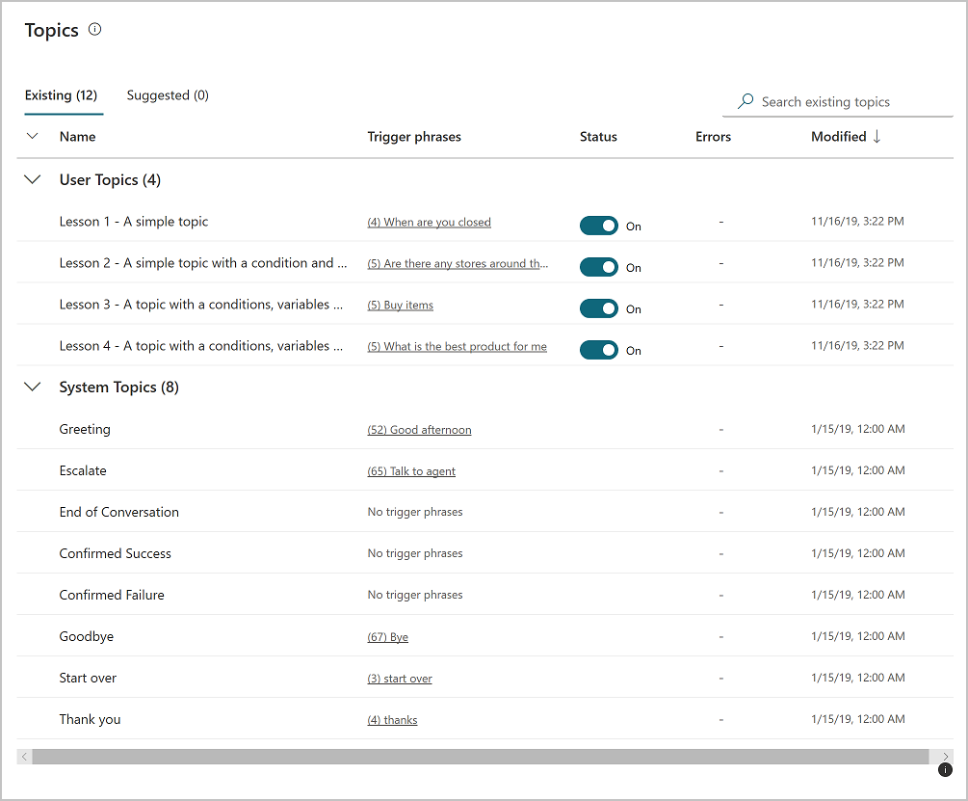
Power Virtual Agents components - Topics
Topics
A topic defines how a chatbot conversation plays out. You can:
Author topics by customizing provided templates
Create new topics from scratch
Get suggestions from existing help sites
Topic types
User Topics
System Topics
Notes:
When you create chatbots with Power Virtual Agents, you author and edit topics. Topics are discrete conversation paths that, when used together within a single chatbot, allow for users to have a conversation with a chatbot that feels natural and flows appropriately.
Topics
In Power Virtual Agents, a topic defines how a chatbot conversation plays out. You can author topics by customizing provided templates, create new topics from scratch, or get suggestions from existing help sites.
A topic has trigger phrases—these are phrases, keywords, or questions that a user is likely to type that is related to a specific issue —and conversation nodes—these are what you use to define how a chatbot should respond and what it should do.
The AI uses natural language understanding to parse what a customer actually types and find the most appropriate trigger phrase or node.
For example, a user might type "Open hours" into your chatbot—the AI will be able to match that to the Store hours topic and begin a conversation that asks which store the customer is interested in, and then display the hours the store is open.
Use system and sample topics
When you create a chatbot, a number of topics will be automatically created for you.
Four prepopulated User Topics that are titled as lessons. These lesson topics can be used to help understand simple to complex ways of using nodes to create chatbot conversations.
A number of System Topics. These are prepopulated topics that you are likely to need during a chatbot conversation. We recommend you keep these and use them until you are comfortable with creating an end-to-end chatbot conversation.
You can edit both of these topic types in the same manner as for topics you create; however, you cannot delete them.

Slide 99
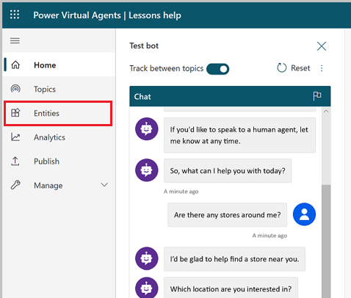
Power Virtual Agents components - Entities
Entities
An entity can be viewed as an information unit that represents a certain type of a real-world subject, like a phone number, zip code, city, or even a person's name.
Entity types
Prebuilt entities
Represents the most commonly used information in real-word dialogs.
Custom entities
Notes:
A big part of chatbot conversations in Power Virtual Agents is natural language understanding, which is the ability for the AI to understand a user's intent. For example, natural language understanding is involved when a user might say "I tried to use my gift card but it doesn't work" and the chatbot is able to route the user to the topic related to gift cards not working—even if that exact phrase isn't listed as a trigger phrase.
One fundamental aspect of natural language understanding is to identify entities in a user dialog. An entity can be viewed as an information unit that represents a certain type of a real-world subject, like a phone number, zip code, city, or even a person's name.
Custom entities: The prebuilt entities cover commonly used information types, but on some occasions, such as when building a chatbot that serves a specific purpose, you will need to teach the chatbot's language understanding model some domain-specific knowledge.

Slide 100
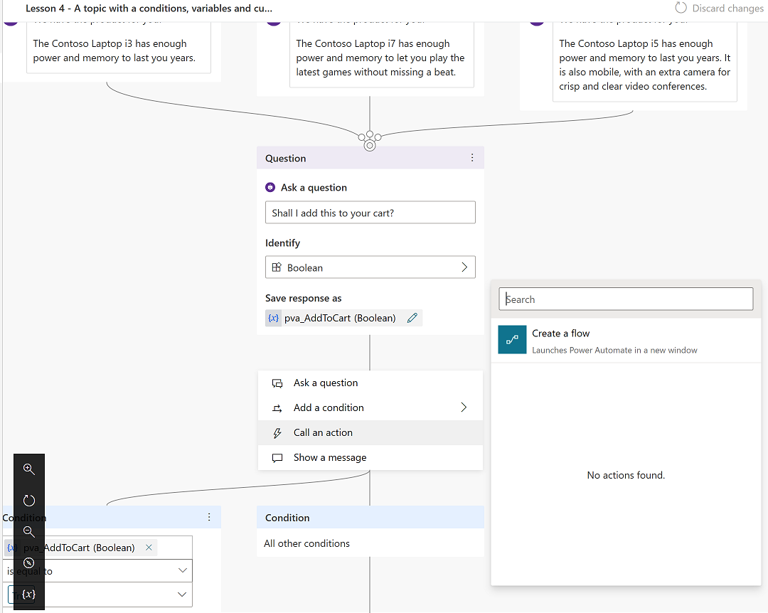
Power Virtual Agents components - Actions
Actions
Enable your chatbot to perform an action by calling a Microsoft Power Automate flow. You can:
Call flows from within topics.
Utilize flows that have already been created in your Power Apps environment.
Create a flow from within the Power Virtual Agents authoring canvas.
Notes:
Flows can help you automate activities or call backend systems. For example, you can use flows with end-user authentication to retrieve information about a user after they sign in.
You can call flows from within topics, as a discrete Call an action node. You can utilize flows that have already been created in your Power Apps environment, or you can create a flow from within the Power Virtual Agents authoring canvas.
Flows typically use variables to input and output information. The variables can then be used in other nodes within the topic.

Slide 101
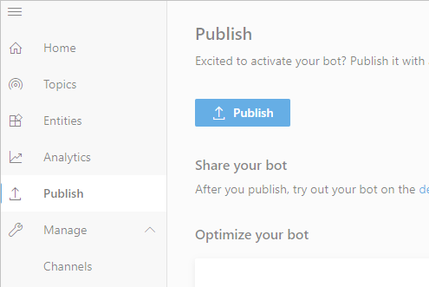
Power Virtual Agents components - Publishing
Publishing
Publish chatbots to engage with your customers on multiple platforms or channels.
Platforms or channels include:
Websites
Mobile app
Facebook
Microsoft Teams
Skype
Cortana
Slack
etc.
Notes:
You can also configure a Power Virtual Agents chatbot to provide authentication capabilities, so users can sign in with any OAuth2 identity provider, such as Azure Active Directory (Azure AD), a Microsoft account, or Facebook.
After you have published at least once, you can connect your chatbot to additional channels.

Slide 102
Module 6 lab
Lab 1: How to build a simple chat

Slide 103
Module 7: Managing M365 Users and Groups

Slide 104
Manage User Accounts
Lab 2-Exercise 1 – Manage Uses with the Microsoft 365 admin center
Managing Passwords and Authentication
Lab 2-Exercise 2 – Manage Password Policies
Managing Groups in Microsoft 365
Lab 2-Exercise 3 – Manage Microsoft 365 Groups
Managing Users and Groups with Windows PowerShell
Lab 2-Exercise 4 – Manage Users with PowerShell
Configuring Administrative Access
Lab 2-Exercise 5 – Configure Service Admins

Slide 105
User account types
Cloud identities:
Exist only in Microsoft 365
Are suitable only for small organizations
Synchronized identities:
Exist in AD DS and Microsoft 365
Can synchronize passwords
Are managed in AD DS
Federated identities:
Add SSO for synchronized identities
Require AD FS
You can implement pass-through authentication as an alternative to AD FS
Notes:
Briefly describe the concept of cloud, synchronized, and federated identities. Mention that synchronized and federated identities are covered in detail later in the course.
20347B
2: Managing Office 365 users and groups

Slide 106
Creating user accounts
User provisioning options include:
Microsoft 365 admin center
Import multiple users
Windows PowerShell
Directory synchronization
Notes:
Describe how to create user accounts by using Microsoft 365 admin center and with bulk import.
20347B
2: Managing Office 365 users and groups

Slide 107
Managing user licenses
While assigning Office 365 service licenses to users, you can:
Replace existing licenses
Add to existing licenses
You can view license information such as:
Unlicensed users
Number of used licenses
Notes:
Describe how to assign licenses to users and the implications of choosing different license subscriptions.
20347B
2: Managing Office 365 users and groups

Slide 108
Managing user accounts
In the Microsoft 365 admin center, you can modify the user settings in the following categories:
Account
Devices
Licenses and Apps
Mail
OneDrive
Notes:
Describe how to modify user accounts after creation, including managing multiple recipients.
20347B
2: Managing Office 365 users and groups

Slide 109
Lab Exercises
Exercise 1: Managing Microsoft 365 users with the Microsoft 365 admin center
Task 1
Create Microsoft 365 Users
Task 2
Edit Microsoft 365 Users
Task 3
Verify User Settings

Slide 110
Managing passwords and authentication

Slide 111
Password policy options
Password policy:
Specify the number of days for password expiration
Specify the number of days for the password expiration warning
Disable password expiration
Resetting user passwords:
Create a new temporary password for users
Resetting admin passwords:
Ask another administrator to reset it for you
Reset it yourself on the sign in screen
Notes:
Describe the options for configuring password policies and managing passwords.
20347B
2: Managing Office 365 users and groups

Slide 112
Planning password policies and authentication
Correctly define the administrator roles
Document and standardize password policies
Enforce the use of strong passwords
Use multi-factor authentication
Ensure that users are educated on organizational security policies
Notes:
Describe the best practices for managing passwords and authentication.
20347B
2: Managing Office 365 users and groups

Slide 113
Lab Exercises (continued)
Exercise 2: Managing Microsoft 365 password policies
Task 1
Configure the Microsoft 365 password policy
Task 2
Validate the password policy
Task 3
Enable and Disable Multi-Factor Authentication

Slide 114
Managing Groups in Microsoft 365

Slide 115
Microsoft 365 Groups
Group types in Microsoft 365 admin center:
Microsoft 365 group
Distribution list
Mail-enabled security group
Security group
Group types in Exchange admin center:
Microsoft 365 group
Distribution group
Security group (mail-enabled)
Dynamic distribution group
SharePoint Online groups can contain security groups
Notes:
Describe the function of groups in Office 365. Compare Microsoft Exchange Online distribution groups, Microsoft SharePoint Online security groups, and Office 365 groups.
20347B
2: Managing Office 365 users and groups

Slide 116
Creating and deleting groups
Security groups are not mail-enabled, but you can create mail-enabled security groups
Use security groups to grant permissions to SharePoint Online sites
Create groups by using the Microsoft 365 admin center or the New-MsolGroup cmdlet
Nest security groups to improve organization
Deleted security groups cannot be recovered, and members are not deleted
Notes:
Demonstrate how to create groups and manage group membership.
20347B
2: Managing Office 365 users and groups

Slide 117
Lab Exercises (continued)
Exercise 3: Managing Microsoft 365 groups
Task 1
Creating Microsoft 365 groups

Slide 118
Managing Users and Groups with Windows PowerShell

Slide 119
Managing Microsoft 365 with Windows PowerShell
Azure AD Connection provides the Azure AD Module for Windows PowerShell
You can use the Azure AD module to connect to Microsoft 365 to perform common and repetitive tasks
Ensure that your environment meets requirements before installing the Azure AD Module for Windows PowerShell
To use the Azure AD Module for Windows PowerShell to manage Microsoft 365:
Install the module
Connect to the service
Get help
Azure AD PowerShell for Graph provides additional features and functionality
Notes:
Provide a brief summary of how to use the Windows PowerShell command-line interface to manage Office 365, and compare it with using the Microsoft 365 admin center.
20347B
2: Managing Office 365 users and groups

Slide 120
Managing users and licenses with Windows PowerShell
To add users and licenses, use the New-MsolUser cmdlet:
Use the-License Assignment switch to assign licenses
To manage licenses, use the Set-MsolUserLicense cmdlet:
Use scripts to bulk update licenses
Use the-License Options switch to assign a subset of licenses
To delete users, use the Remove-MsolUser cmdlet:
In a soft delete, a user account remains in the recycle bin for 30 days
In a hard delete, a user account is permanently deleted from the recycle bin
To restore users, use the Restore-MsolUser cmdlet within 30 days
Notes:
Demonstrate commands and examples of managing user accounts by using Windows PowerShell.
20347B
2: Managing Office 365 users and groups

Slide 121
Managing groups with Windows PowerShell
Task | Cmdlet
Create security groups | New-MsolGroup
Delete security groups | Remove-MsolGroup
Add users and remove users from a security group | Get-MsolUser (to retrieve ObjectId) Add-MsolGroupMember Remove-MsolGroupMember
Notes:
Demonstrate commands and examples of managing group accounts by using Windows PowerShell.
20347B
2: Managing Office 365 users and groups

Slide 122
Importing users and groups with Windows PowerShell
Use the Import-Csv cmdlet with a CSV file to import users or groups
The CSV file includes user or group objects and their properties
The New-MsolUser cmdlet creates user objects based on the information from the CSV file
The New-MsolGroup cmdlet creates group objects based on the information from the CSV file
Notes:
Demonstrate how to import users and groups by Using Windows PowerShell.
20347B
2: Managing Office 365 users and groups

Slide 123
Managing users and groups with Windows PowerShell
Use a Windows PowerShell script to manage multiple users and groups
Windows PowerShell scripts might include the following cmdlets:
Import-Module to import a specific module, such as the Exchange Online module
Import-Session to import the Office 365 session in the current shell
Set-MsolUser to configure users
Set-MsolUserLicense to configure user licenses
Set-MsolGroup to configure groups
Notes:
Demonstrate the scripts that the topic content discussed.
20347B
2: Managing Office 365 users and groups

Slide 124
Configuring password policies with Windows PowerShell
Change and reset user passwords
Set tenant password policies:
Password expiration
Password expiration notification warning
Configure user passwords to never expire
Remove the Password Never Expires setting
View which user passwords are set to never expire:
Applicable for a single user or all users
Remove strong password complexity requirements on a per-user basis
Notes:
Demonstrate how to configure password policies by using Windows PowerShell.
20347B
2: Managing Office 365 users and groups

Slide 125


Discussion: Microsoft 365 admin center vs. Windows PowerShell
What are the benefits of managing the Microsoft 365 tenant with the Microsoft 365 admin center? With Windows PowerShell?
In what scenario will you administer users and groups with the Microsoft 365 admin center? With Windows PowerShell?
15 minutes…Go!
Notes:
Use the discussion to draw out students’ thoughts on using Windows PowerShell to administer users and groups in Office 365 tenant compared to the Microsoft 365 admin center.
20347B
2: Managing Office 365 users and groups

Slide 126
Exercise 4

Slide 127
Lab Exercises (continued)
Exercise 4: Managing Microsoft 365 users and groups with Windows PowerShell
Task 1
Installing Azure AD module for Windows PowerShell
Task 2
Create new users & assign licenses with PowerShell
Task 3
Bulk import users with PowerShell
Task 4
Configure group membership with PowerShell
Task 5
Configure user passwords with PowerShell

Slide 128
Configuring administrative access

Slide 129
Microsoft 365 administrator roles
Microsoft 365 admin center role name | Windows PowerShell role name | Role tasks
Global administrator | Company administrator | Perform all administrative tasks
Billing administrator | Billing administrator | Make purchases, manage subscriptions, manage support tickets, and monitor service health
Password administrator | Helpdesk administrator | Change and reset passwords, manage service requests, and monitor service health
Service administrator | Service support administrator | Manage service requests and monitor service health
User management administrator | User account administrator | Create and delete users and groups, reset passwords, manage service requests, and monitor service health
Notes:
Describe the Office 365 administrator roles. Highlight that Windows PowerShell administrator names are different from Office 365 administrator names.
20347B
2: Managing Office 365 users and groups

Slide 130
Assigning administrator roles
In the Microsoft 365 admin center:
Select Users > Active users
Select a user
Under Edit user roles, assign a role, and then provide an alternate email address
In Windows PowerShell, use the following commands:
Get-MsolRole
Get-MsolUserRole
Get-MsolUserRoleMember
Add-MsolRoleMember
Remove-MsolRoleMember
Notes:
Show how to assign administrator roles, including how to assign roles by using Windows PowerShell.
20347B
2: Managing Office 365 users and groups

Slide 131
Planning delegated administration
Delegated administration process:
Open the offer email message from the partner
Navigate to the authorization page in Microsoft 365
Authorize the partner
Create the trial or subscription account
Partner-assigned administration roles:
Full administration – Same as global administrator
Limited administration – Same as password administrator
Notes:
Describe the best practices for delegating administration.
20347B
2: Managing Office 365 users and groups

Slide 132
Lab Exercises (continued)
Exercise 5: Configuring Service Administrators
Task 1
Assign delegated admins in the Microsoft 365 admin center
Task 2
Assign delegated admins with Windows PowerShell
Task 3
Verify delegated administration

